Slide 1
Islamic Repo & Collateralization Possibilities
OIC Member States’ Stock Exchanges Forum 4th Meeting
Saturday, 2nd Oct 2010
Istanbul, Turkey
Ijlal Ahmed Alvi
Chief Executive Officer
IIFM

Slide 2
IIFM Reference Paper on I’aadat Al Shira’a (Repo Alternative) and Collateralization Possibilities
Published on 28th July 2010
Purpose
The Reference Paper aims to provide general information on the concept, operational mechanism and uses of conventional repurchase agreements (known as Repo or Sale and Repurchase agreements) and explore the possibilities for I’aadat Al Shira’a (repurchase) as an alternative to Repo
The aim is to provide for the Islamic financial institutions, another tool to effectively manage its liquidity as well as to help it finance its inventory of Asset, Sukuk and equities
Continued…

Slide 3
IIFM Reference Paper on I’aadat Al Shira’a (Repo Alternative) and Collateralization Possibilities
Recommendation
Concept 3 – Three Party Structure I’aadat Al Shira’a
The three party structure should be explored further by involving an active Repo Stock Exchange such as the clearing company of Istanbul Stock Exchange or bringing other financial institution such as a clearing house or custodian bank who will be willing to assume the risks of acting as a third party and not the agent role as is the case with conventional tri-party repo
Continued…

Slide 4
IIFM Reference Paper on I’aadat Al Shira’a (Repo Alternative) and Collateralization Possibilities
Recommendation
Concept 4 – Collateralized I’aadat Al Shira’a
Institutions may initiate this concept which will give similar results as those achieved by a repo. Moreover, this concept will allow Islamic financial institutions to raise cash to fund the inventory while providing the cash investor a return which is further comforted in form of collateral

Slide 5
IIFM Reference Paper on I’aadat Al Shira’a (Repo Alternative) and Collateralization Possibilities
Concept 3 – Three Party I’aadat Al Shira’a ‘IS’
(i) Overview of Structure
The major difference between a conventional Tri-Party repo and the Three Party ‘IS’ under consideration is that, in the case of a conventional repo, the role of the third party is that of an Agent while for the Three Party ‘IS’ the third party will act as a principal even though It is acting in an intermediary capacity between the other two parties. Therefore, the working team has named this structure Three Party ‘IS’, as the seller, the buyer and the third party are all required to assume risk.
Continued…

Slide 6
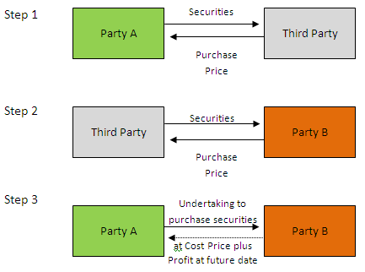
IIFM Reference Paper on I’aadat Al Shira’a (Repo Alternative) and Collateralization Possibilities
Concept 3 – Three Party I’aadat Al Shira’a ‘IS’
Continued…

Slide 7
IIFM Reference Paper on I’aadat Al Shira’a (Repo Alternative) and Collateralization Possibilities
Concept 3 – Three Party I’aadat Al Shira’a ‘IS’
Step 1: Party A sells securities to a third party (who may be a broker, a clearing agent, a custodian or another third party) against the payment of cash (ideally the aim should be to find an independent third party such as the clearing house of a Stock Exchange or a custodian bank)
Step 2: The third party immediately sells the securities to Party B against the payment of cash
Step 3: Party A undertakes to Party B to buy equivalent securities at maturity at a specified agreed price.
Continued…

Slide 8
IIFM Reference Paper on I’aadat Al Shira’a (Repo Alternative) and Collateralization Possibilities
Concept 3 – Three Party I’aadat Al Shira’a ‘IS’
(ii) Issues for Consideration
Underlying securities:
The securities involved need to be Shari'ah compliant. Sukuk would in principle be satisfactory, as would other Shari’ah compliant securities such as Shari’ah compliant equities
(b) The parties will need a basis for agreeing what securities are acceptable to them both for these purposes
Continued…

Slide 9
IIFM Reference Paper on I’aadat Al Shira’a (Repo Alternative) and Collateralization Possibilities
Concept 3 – Three Party I’aadat Al Shira’a ‘IS’
(ii) Issues for Consideration
Margin
Consideration needs to be given to the following:
How to replicate margin maintenance? A Shari’ah compliant basis for valuing the collateral and delivering more collateral or returning some collateral needs to be determined in cash or Sukuk form
Re-pricing of transactions in terms of pricing Data, Hair Cut, Margin Variances and the actual mechanic of booking and transferring the cash or the securities
How to deal with margin which is cash? Under conventional repo documentation cash margin represents an interest bearing debt obligation – this could be replicated with Murabaha and Reverse Murabaha. An alternative may be either to generate cash through a Murabaha transaction or to use an instrument like an L/C as an alternative to cash Continued…

Slide 10
IIFM Reference Paper on I’aadat Al Shira’a (Repo Alternative) and Collateralization Possibilities
Concept 3 – Three Party I’aadat Al Shira’a ‘IS’
(ii) Issues for Consideration
How to effect collateralization? In conventional repo documentation, the collateralization technique used is usually netting i.e. the ability to close out and set off in an insolvency where the value of the collateral securities can be determined and applied in set off against the repurchase price. The lack of recognition of set off in many GCC countries means that the applicability and efficacy of this technique would be limited for the present
Complicating steps of going through 3 parties every time there is a margin call
Continued…

Slide 11
IIFM Reference Paper on I’aadat Al Shira’a (Repo Alternative) and Collateralization Possibilities
Concept 3 – Three Party I’aadat Al Shira’a ‘IS’
(ii) Issues for Consideration
Accounting Treatment – Confirmation of the accounting treatment that would be applied to a repo structured in this way.
Third Party Credit Risk – The parties will be taking settlement credit risk on the third party in respect of its obligations. Any third party involved would also be taking risk on the parties and would need to be comfortable with this.
Income Treatment – Consideration as to whether there should be a mechanism for passing to Party A the income on coupon or dividend securities received prior to Party A's Undertaking being exercised or whether the income should simply be reflected in the "Repurchase Price“
Continued…

Slide 12
IIFM Reference Paper on I’aadat Al Shira’a (Repo Alternative) and Collateralization Possibilities
Concept 3 – Three Party I’aadat Al Shira’a ‘IS’
(ii) Issues for Consideration
Master Terms – Shari'ah acceptance of the Master terms and conditions have certain obligations which may be regarded by Shari’ah as adversely affecting the unilateral nature of the Wa’ad.
Party B Undertaking – Consideration needs to be given to whether an Undertaking from Party B is required to ensure on-sale by Party B of the equivalent securities should their value exceed the "Repurchase Price". From a Shari'ah perspective, it may not be permissible to make such an Undertaking binding on Party B.
Netting Issues – As indicated above, the applicability and efficacy of netting is a practical issue with this structure. There is a need to develop law provisions allowing effective netting.
Continued…

Slide 13
IIFM Reference Paper on I’aadat Al Shira’a (Repo Alternative) and Collateralization Possibilities
Concept 3 – Three Party I’aadat Al Shira’a ‘IS’
(iii) Shari’ah issues to be tackled
I’aadat Al Shira’a ‘IS’ if affected on a three party basis is possible and the recommended approach by some scholars, although resolution is still required on the following:
Type of arrangement between A & B and what form of undertaking
Whether the undertaking may be a unilateral undertaking or simple undertaking
Whether B has the right to exercise: If yes then, this may raise Shari’ah issues
Contingent contracts and entering the contract now for future (has to be non-contingent contracts)
Undertaking by B to A; has to be developed based on different scenarios
Linking of undertaking and transactions, keeping in view the Shari’ah rulings
Continued…

Slide 14
IIFM Reference Paper on I’aadat Al Shira’a (Repo Alternative) and Collateralization Possibilities
Concept 3 – Three Party I’aadat Al Shira’a ‘IS’
(iv) Conclusion
The working team is of the view that this concept should be further developed based on the above findings and the third party who is willing to step in as principal. Moreover, as mentioned in the background, the ‘third party’ will be required to assume risk similar to the CBB structure. It is also recommended that Islamic Development Bank (multilateral institution) or clearing company of a major OIC Stock Exchange (could be Istanbul Stock Exchange) or clearing/custodian institution may assume the role of principal in Three Party Concept.
Continued…

Slide 15
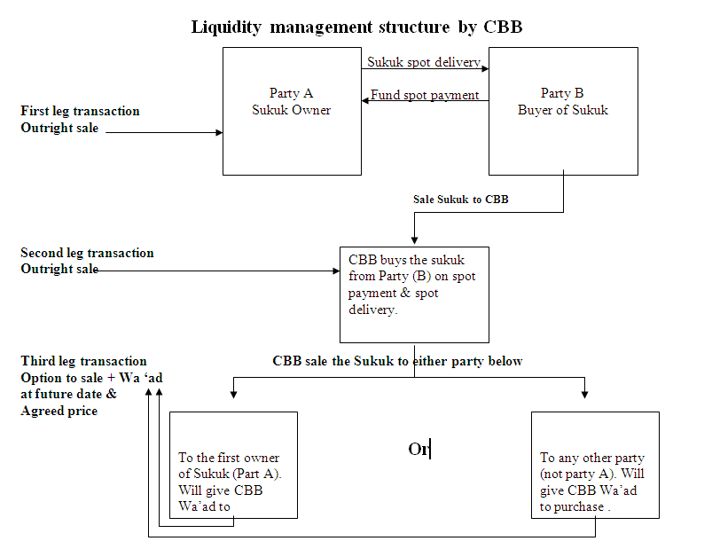
IIFM Reference Paper on I’aadat Al Shira’a (Repo Alternative) and Collateralization Possibilities
Concept 3 – Three Party I’aadat Al Shira’a ‘IS’
Jurisdictional Approach by Bahrain

Slide 16
IIFM Reference Paper on I’aadat Al Shira’a (Repo Alternative) and Collateralization Possibilities
Clearing company as third party - consideration
Risk Taking – Clearing company do take risk in transaction as against no risk by custodian/agent
Operational mechanism may need to be developed considering Shari’ah apprehension in three party structures
CBB liquidity management tool process or innovative process
Order Book maintenance by clearing company for forward trades
Continued…

Slide 17
IIFM Reference Paper on I’aadat Al Shira’a (Repo Alternative) and Collateralization Possibilities
Concept 4 – Collateralized I’aadat Al Shira’a ‘IS’
In order to make use of parties Sukuk portfolios and to initiate the process while further research and deliberation on finding an ideal ‘IS’ structure may continue, the working team is of the view that a collateralized structure is one of the options which perhaps can be initiated now given the industry’s urgent requirement for a workable liquidity management tool.
The proposal is to make use of Sukuk, which are currently not utilized in a bank’s portfolio, through either a Murabaha or Wakala arrangement. Since Murabaha is more developed and widely used, the working team is of the view that the following proposed structure may be initiated in various jurisdictions so that not only do funds remain within the Islamic system but the required legal procedures can be managed at the jurisdiction level (the suggestion is to seek required legal changes in OIC countries to facilitate the process).
Sukuk collateralization through a Wakala arrangement is another option which, if required, can be further developed by the IIFM working team if requested by the industry.
Continued…

Slide 18
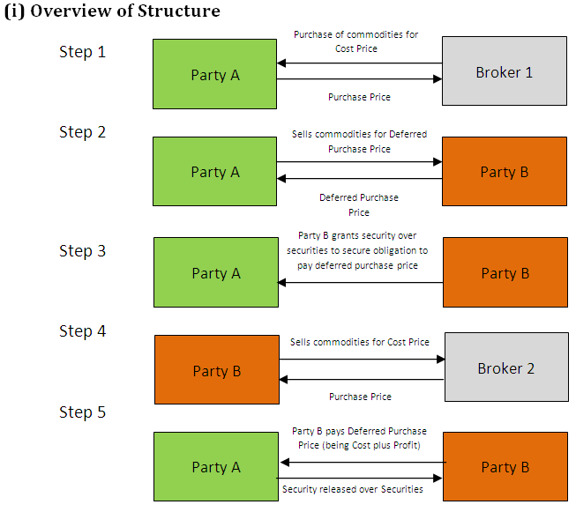
IIFM Reference Paper on I’aadat Al Shira’a (Repo Alternative) and Collateralization Possibilities
Concept 4 – Collateralized I’aadat Al Shira’a ‘IS’
To show how the structure will work the following commodity Murabaha based structure is proposed for illustrative purposes only:
Continued…

Slide 19
IIFM Reference Paper on I’aadat Al Shira’a (Repo Alternative) and Collateralization Possibilities
Concept 4 – Collateralized I’aadat Al Shira’a ‘IS’
Step 1: Party A buys commodities ("Commodities") from a broker 1 against payment of the cash purchase price.
Step 2: Party A sells the Commodities to Party B against payment of a deferred purchase price (being cost plus profit) (the "Deferred Purchase Price").
Step 3: As security for payment of the Deferred Purchase Price, Party B grants security over securities held by it in favor of Party A.
Step 4: Party B sells the Commodities to a broker against payment of the cash purchase price.
Step 5: At "maturity", Party B pays the Deferred Purchase Price to Party A and the security granted in favor of Party A is released.
Continued…

Slide 20
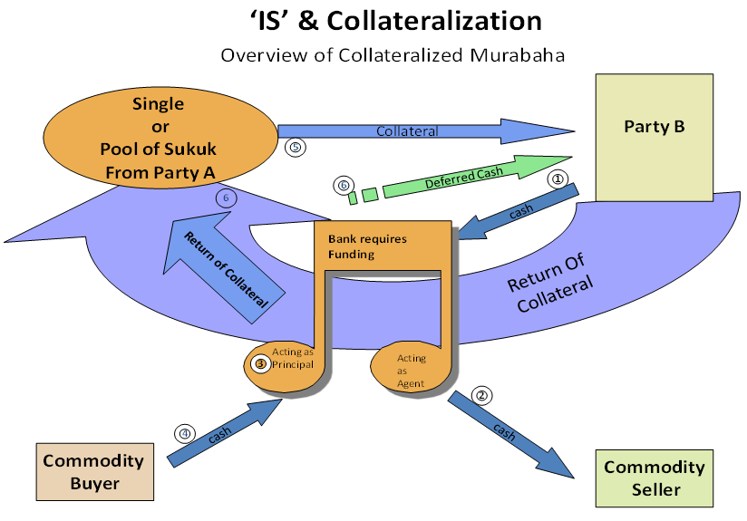
IIFM Reference Paper on I’aadat Al Shira’a (Repo Alternative) and Collateralization Possibilities
Concept 4 – Collateralized I’aadat Al Shira’a ‘IS’
(ii) Working of Collateralization
Continued…

Slide 21
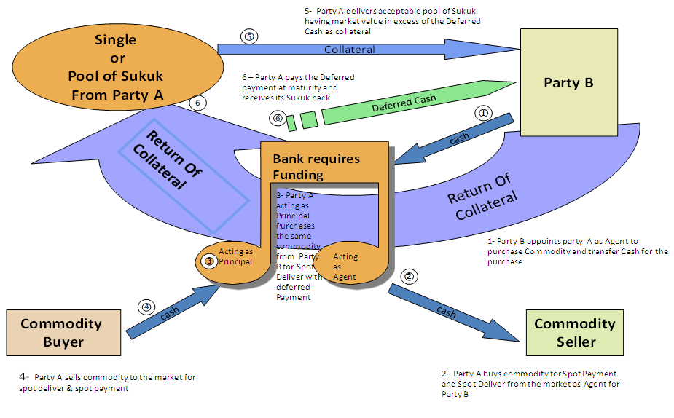
IIFM Reference Paper on I’aadat Al Shira’a (Repo Alternative) and Collateralization Possibilities
Concept 4 – Collateralized I’aadat Al Shira’a ‘IS’
(ii) Working of Collateralization

Slide 22
IIFM Reference Paper on I’aadat Al Shira’a (Repo Alternative) and Collateralization Possibilities
Concept 4 – Collateralized I’aadat Al Shira’a ‘IS’
a) Transactional Steps
Step One – Both parties agrees on Term of the transaction, the mark up, type of Sukuk, and Margin call parameters (Haircut, Threshold & Base Currency)
Step Two – Party B invest $100 million Cash for say1 Month via a Murabaha transaction with a local bank
Step Three – Party B receives acceptable Sukuk as agreed by both parties to a value of $ 110 million to collateralize the exposure and allow 5% variance on both side. Reason to provide 10 million extra coverage is to allow for price fluctuation and to reduce the movement of Collateral back and forth
Step Four –Assuming Collateral fluctuation remains within the band then on the deferred maturity date the Party B receives its $ 100 million + the profit and the Party B returns all of the Sukuk Collateral to the Islamic bank
Continued…

Slide 23
IIFM Reference Paper on I’aadat Al Shira’a (Repo Alternative) and Collateralization Possibilities
Concept 4 – Collateralized I’aadat Al Shira’a ‘IS’
b) Assuming the Collateral Value Decreases Below the Threshold Variance
Bank to provide more (same or other) acceptable Sukuk
Provide other acceptable Collateral as previously agreed
Or Provide acceptable Letter of Credit
Or Provide Reverse Murabaha
To bring the collateral level back to 110%
If none of the above agreed instrument is delivered then the Party A will be in Default
The Party B will Return part of the Sukuk in order to bring it down to 110% of the Murabaha Amount
Or the Party A may consider not to request this extra amount from the Party B if it wishes to leave extra buffer and save of operational cost Continued…

Slide 24
IIFM Reference Paper on I’aadat Al Shira’a (Repo Alternative) and Collateralization Possibilities
Concept 4 – Collateralized I’aadat Al Shira’a ‘IS’
c) Commitment of Both Parties
At all times during the 1 Month Murabaha a 100% to 110 % collateral cover will be maintained against its Deferred payment exposure
Any Increase above the 115%, Party A has the right to call collateral back
Any Decrease below 105%, Party B has the right to ask for Top up
d) Notes & Considerations
The counter parties could be Bank and Central Bank, or Banks and any Financial Institution
Sukuk could be clearing house based as well as domestic Sukuk
Rating benefit is taken as implied
Other securities which could be used as collateral are not considered at this time
Use of collateral i.e. Sukuk by CB and FI – probably FI is likely to use Sukuk as compared to CB
Governing Law – seems English law needs to be used
Clearing system based Sukuk and its treatment?
Accounting treatment for collateral assuming leaving pledge or security interest Continued…

Slide 25
IIFM Reference Paper on I’aadat Al Shira’a (Repo Alternative) and Collateralization Possibilities
Concept 4 – Collateralized I’aadat Al Shira’a ‘IS’
(iii) Issues for Consideration
Taking Security: For this structure to be practical, it would need to be possible to take security over the securities quickly, effectively and robustly. In addition it needs to be possible for Party A to re-hypothecate the securities over which Party B has granted security.
Securities used as security for the obligation to pay Deferred Purchase Price: It is presumed that the securities used as security will be limited to Shari’ah compliant securities.
Margin Maintenance: The margin maintenance methodology also needs to be resolved and again needs to be quick, effective and robust. Easiest form would be to add or return Sukuk depending on collateral level agreement
Continued…

Slide 26
IIFM Reference Paper on I’aadat Al Shira’a (Repo Alternative) and Collateralization Possibilities
Concept 4 – Collateralized I’aadat Al Shira’a ‘IS’
(iii) Issues for Consideration
Broker Credit Risk: The parties will be taking a credit risk on the commodity broker in respect of its obligations. However, this is similar to standard commodity Murabaha documentation.
Re-hypothecation: In conventional repo, the buyer has an ability to make use of the repo’d securities in its own business, which adds to the economic value of the repo to the buyer. How to replicate this in Shari’ah complaint way needs to be determined. Potentially Title Transfer Agreement may achieve the desired result.
Accounting Treatment: The applicable accounting treatment would need to be clarified.

Slide 27
IIFM Reference Paper on I’aadat Al Shira’a (Repo Alternative) and Collateralization Possibilities
Proposed Structures Documentation (once the structure is approved)
Concept 3: Three Party Structure ‘IS’ – Proposed documentation
Party A – Third Party Sale Agreement
Party B – Third Party Sale Agreement
Undertaking from Party A in favour of Party B ("Party A Undertaking")
Undertaking from Party B in favour of Party A ("Party B Undertaking")
Master terms and conditions between Party A and Party B
Concept 4: Collateralized ‘IS’ – Proposed Documentation
Party A – Broker Commodity Sale Agreement
Party B – Broker Commodity Sale Agreement
Party A – Party B Commodity Sale Agreement (to include any other terms between the parties such as events of default etc.)
Collateral Document
[Potential Title Transfer Agreement]

Slide 28
THANK YOU
www.iifm.net

