Slide 1

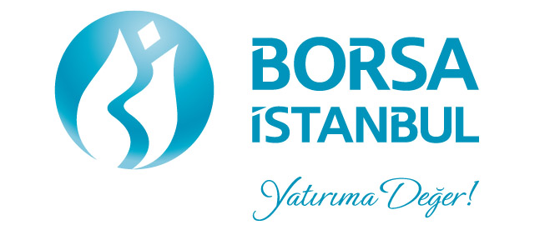
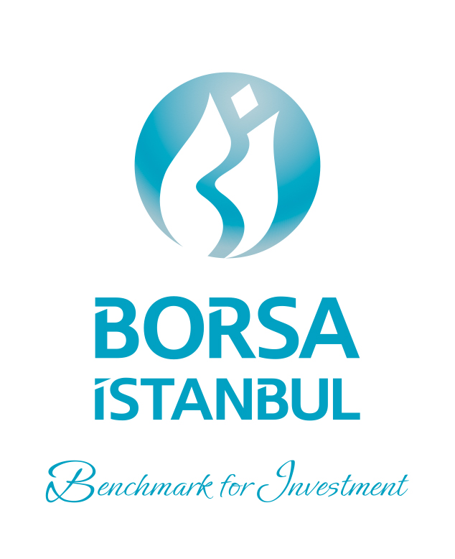
OIC Member States’ Stock Exchanges Forum 10th Meeting
October 27, 2016

Slide 2
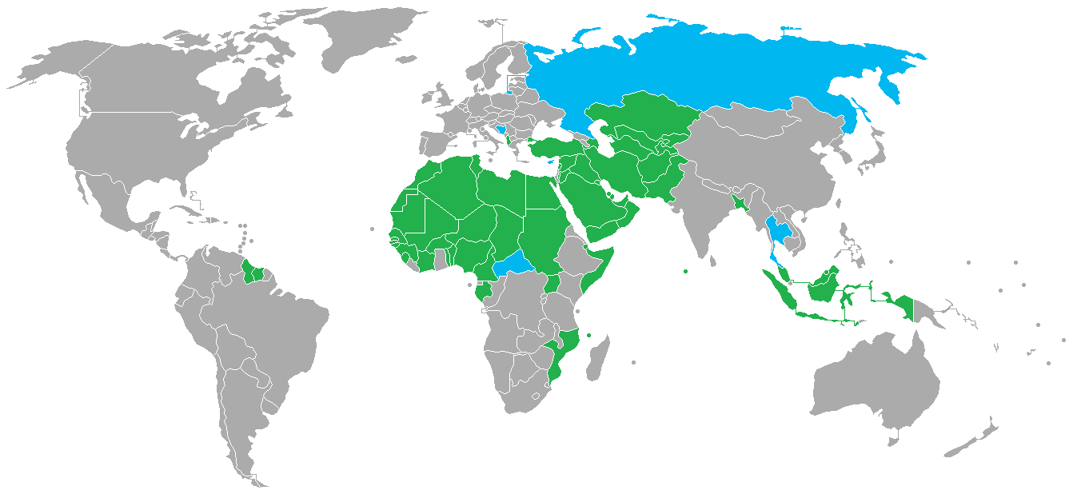
Background
Observers
Members
Initiated at the 20th session of the Standing Committee for Economic and Commercial Cooperation of the OIC (COMCEC) in 2004
Dedicated platform and communication channel for the members
Currently 53 exchanges from 46 countries:
    40 national and 2 regional stock exchanges
    11 commodity exchanges
    20 clearing, settlement, registry and depository institutions
    11 related organizations (SESRIC, IIFM, IFSB etc.)
2

Slide 3
Meetings
First Round-table Meeting, Istanbul – March 2005
Second Annual Meeting, Istanbul – October 2008
  A working committee and four task forces established
  First Working Committee Meeting, Tehran – May 2009
Third Annual Meeting, Istanbul – October 2009
  Task forces renamed and new tasks assigned
  Final Report submitted to the COMCEC
  In the COMCEC meeting, regulatory bodies of the OIC member states requested to establish a similar platform to boost cooperation efforts
Third Working Committee Meeting, Abu Dhabi – April 2010
  Fourth Annual Meeting, Istanbul – October 2010
  Fourth Working Committee meeting – April 2011 -
    Cancelled due to the conflicts in the MENA region (Cancelled due to the conflicts in the MENA)
  Fifth Annual Meeting, Istanbul – September 2011
  Sixth Annual Meeting, Istanbul – September 26, 2012
  Seventh Annual Meeting, Istanbul – September 16, 2013
  Eight Annual Meeting, Istanbul – November 11, 2014
  Ninth Annual Meeting, Istanbul – November 19, 2015
3

Slide 4
Forum Participation
4

Slide 5
Current Activities of the Forum
Task Force on Indices (S&P/OIC COMCEC 50 Shariah Index)
Taskforce on Precious Metals(OIC Gold Exchange)
OIC Exchanges Website
Quarterly Newsletters
Annual Statistics Report (Exchanges and CSDs)
Report on Gold Trading among OIC States
5

Slide 6
Task Forces
Task Force on Indices
  S&P/ OIC COMCEC 50 Shariah Index launched on June 25, 2012
  Measures performance of 50 leading Shariah-compliant companies from 19 OIC member states
  Screened for Shariah compliance by S&P in accordance with S&P Shariah Indices
Precious Metals Task Force
  Established by a decision taken at the 9th Forum Meeting
  Bursa Malaysia, Borsa Istanbul and Dubai Gold and Commedities Exchange are the members
6

Slide 7
Task Forces
At the thirty-first meeting of the Follow-Up Committee of the COMCEC, which was held in Ankara on 13-14 May, 2015, following decision was made:
  Recalling the proposal made in the statement of H.E. Recep Tayyip ERDOĞAN, Chairman of the COMCEC, in the 30th Session of the COMCEC, on establishing a Gold Exchange among the OIC Member Countries, the Committee requested the Secretariat of the OIC Stock Exchange Forum to conduct a study on the feasibility and the ways and means of realizing the proposal and submit it to the 31st Session of the COMCEC.
Report on the OIC Gold Exchange was prepared. It was submitted to the 31st COMCEC Ministerial Meeting on 23-26 November.
  Welcomes the report on “Gold Market Initiative for the OIC Member Countries” prepared by the OIC Member States' Stock Exchanges Forum and requests it to further study, through its Task Force on Precious Metals, to accelerate the process of integration of exchanges and harmonization of regulatory frameworks with a view to establishing a gold exchange among the OIC Member Countries and submit a report on this issue to the 32nd Session of the COMCEC.
Second report of the OIC Gold Exchange will be submitted to the 32nd COMCEC Ministerial Meeting on 21-24 November 2016.
7

Slide 8
8

Slide 9
OIC Exchanges Survey
As decided at the 7th meeting of the OIC Member States’ Stock Exchanges Forum in 2013, Borsa İstanbul as the Forum Coordinator presents the third issue of the Integrated Statistical Report, which covers 2014-2015 periods of the exchanges and the central securities depositories of the OIC Member States
17 stock exchanges, 1 commodities exchange and 7 central securities depositories have responded to the survey
The patterns, trends, and other results presented in this report are based on the sets of 20 exchanges and 7depositories. Therefore, these sets will be referred as “OIC Exchanges” and “OIC CSDs” collectively
  The data for 2 exchanges were collected from WFE
9

Slide 10
Survey: Participants
Stock Exchanges
State | Name | Acronym | Source
United Arab Emirates | Abu Dhabi Securities Exchange | ADX* | Survey
Jordan | Amman Stock Exchange | ASE | Survey
Turkey | Borsa İstanbul | BIST | Survey
Malaysia | Bursa Malaysia Berhad | BM* | Survey
Mozambique | Bolsa de Valores de Moçambique | BVM* | Survey
Bangladesh | Chittagong Stock Exchange | CSE(B)* | Survey
Morocco | Casablanca Stock Exchange | CSE(M) | WFE
United Arab Emirates | Dubai Financial Market | DFM* | Survey
Egypt | The Egyptian Exchange | EGX | Survey
Indonesia | Indonesia Stock Exchange | IDX | WFE
Iran | Iran Fara Bourse Company | IFB | Survey
Iraq | Iraq Stock Exchange | ISX* | Survey
Kazakhstan | Kazakhstan Stock Exchange | KASE | Survey
Maldives | Maldives Stock Exchange Pvt Ltd | MSE* | Survey
Palestine | Palestine Securities Exchange | PEX* | Survey
Qatar | Qatar Stock Exchange | QSE | Survey
Algeria | Algiers Stock Exchange | SGBV | Survey
Saudi Arabia | Saudi Stock Exchange | Tadawul* | Survey
Iran | Tehran Stock Exchange | TSE | Survey
10

Slide 11
Survey: Participants
Commodities Exchanges
State | Name | Acronym | Source
Pakistan | Pakistan Mercantile Exchange | PMEX | Survey
Central Securities Depositories
State | Name | Acronym | Source
Algeria | Algeria Central Securities Depository | AC | Survey
Pakistan | Central Depository Company of Pakistan Ltd | CDC | Survey
Iran | Central Securities Depository of Iran | CSDI | Survey
Morocco | Maroclear CSD Morocco | Maroclear | Survey
Turkey | Central Registry Agency | MKK | Survey
Jordan | Securities Depository Center of Jordan | SDC | Survey
Tunisia | Tunisie Clearing | TC | Survey
11

Slide 12
Survey: Equities
OIC Exchanges have represented $2 trillion of the world equities markets in 2015 with an 16% annual decrease in the market capitalization and a 22% annual decrease in the value of trading for all equities products, compared to 1.3% decrease and 41% increase of the WFE averages respectively.
  ETFs
ADX, BIST, BM, EGX, IDX, IFB, Tadawul, and TSE have 49 ETF products, with the value of trading of $1.8 billion in 2015, which is a 8% decrease from 2014
80% of the value traded was executed at Borsa İstanbul with 12 products
 | ADX | ASE | BIST | BM | BVM | CSE (B) | CSE (M) | DFM | EGX | IDX | IFB | ISX | KASE | MSE | PEX | PMEX | QSE | SGBV | Tadawul | TSE
Shares | l | l | l | l | l | l | l | l | l | l | l |  | l | l | l |  | l | l | l | l
Securitized Derivatives |  |  | l | l |  |  |  |  |  |  | l |  |  |  |  |  |  |  |  | l
ETFs | l |  | l | l |  |  |  |  | l | l | l |  |  |  |  |  |  |  | l | l
Investment Funds | l |  | l | l |  | l |  |  | l |  |  |  | l |  |  |  |  |  | l
12

Slide 13
Survey: Debt Instruments
The outstanding value of debt instruments listed at the OIC Exchanges was $546.2 billion with a 4% annual decrease
The value of trading for the 1608 instruments listed by 474 issuers was $312.8 billion which is a 49% annual increase from 2014.
Borsa İstanbul is leading exchange in OIC debt securities markets with 42% of the value of instruments listed, 62% of the raised funds from debt securities, and 86% of the value of trades.
Domestic public instruments are leading the markets; private and foreign bonds are relatively illiquid.
 | ADX | ASE | BIST | BM | BVM | CSE (B) | CSE (M) | DFM | EGX | IDX | IFB | ISX | KASE | MSE | PEX | PMEX | QSE | SGBV | Tadawul | TSE
Domestic Public |  | l | l |  | l |  | l | l | l | l | l | l | l |  |  |  | l |  | l | l
Domestic Private |  | l | l | l | l | l | l | l | l | l | l | l | l | l |  |  |  |  | l
Foreign |  |  | l |  |  |  |  |  |  |  |  |  | l
REPO |  |  | l |  |  |  |  |  |  |  |  |  | l
13

Slide 14
Survey: Derivatives
 | ADX | ASE | BIST | BM | BVM | CSE (B) | CSE (M) | DFM | EGX | IDX | IFB | ISX | KASE | MSE | PEX | PMEX | QSE | SGBV | Tadawul | TSE
Stock Futures |  |  | l | l |  |  |  |  |  |  |  |  | l |  |  |  |  |  |  | l
Stock Index Futures |  |  | l | l |  |  |  |  |  |  |  |  | l
ETF Futures |  |  | l
Interest Rate Futures |  |  | l | l
Currency Futures |  |  | l |  |  |  |  |  |  |  |  |  | l |  |  | l
Commodity Futures |  |  | l | l |  |  |  |  |  |  |  |  |  |  |  | l
Stock Options |  |  | l |  |  |  |  |  |  |  |  |  |  |  |  |  |  |  |  | l
Stock Index Options |  |  | l | l
ETF Options
Interest Rate Options
Currency Options |  |  | l
Commodity Options |  |  |  | l
Five exchanges had derivatives contracts available for trading with a total of 108.2 million contracts traded in 2015, which is a 43% annual increase from the number of contracts traded in 2014.
14

Slide 15
Survey: CSDs
As of the end of 2015, there were a total of 3,952 domestic with a 5% annual increase and 30 foreign issuers with no change from 2014
26,957,888 investor accounts at the end of 2015, a 6% annual increase from 2014
50% of the participating OIC CSDs have omnibus accounts at the participant level
88% have beneficial ownership accounts on an end-investor basis
75% mandates the accounts to be segregated on an end-investor basis
Dematerialization is mandatory at 75% of the CSDs.
15

Slide 16
The Way Forward
OIC Forum
Discussion
Cooperation
Coordination
Open Debate
Promotion
16
Notes:
The Forum’s main objective is to gather OIC Exchanges in an annual basis and to provide an opportunity for open debate. The Forum Coordinator will show its best effort to ensure communication and coordination among Forum Members. Members are asked to provide topics and questions for discussion for the following meetings.

Slide 17
Thank you!

