Slide 1
OIC Members’ State
Stock Exchanges Forum
Investor Education
The Bursa Malaysia Story
_________________________________________________
Sairana Mohd Saad
Head of Marketing & Communications,
Islamic Markets

Slide 2
Content
Brief Overview on Bursa Malaysia
Business Lines
Market Education & Engagements
4. Islamic Markets
Sukuk Listings
Bursa Suq Al-Sila’
5. Marketing Communication Plan

Slide 3
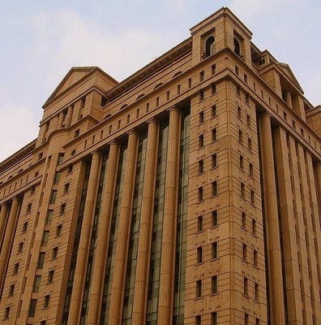
Who is Bursa Malaysia Berhad (1818) ?
The sole integrated exchange in Malaysia offering a complete range of services through our subsidiaries.
This includes exchange-related services e.g.:
Trading
Clearing
Settlement
Depository Services
Information services

Slide 4
Bursa Malaysia
Exchanges
Clearing, Settlement & Depository
Islamic Market Business
Bursa Malaysia Securities Berhad
Bursa Malaysia Securities Clearing Sdn Bhd
Bursa Malaysia Islamic Services Sdn Bhd
Bursa Malaysia Derivatives Berhad
Bursa Malaysia Derivatives Clearing Berhad
Services Provided
Bursa Malaysia Bonds Sdn Bhd
Labuan International Financial Exchange
Bursa Malaysia Depository Sdn Bhd
Bursa Malaysia Information Sdn Bhd

Slide 5
Our Regulatory Role – maintain market integrity
REGULATORY KEY GOALS FOR 2010
BACKGROUND FOR THE REGULATORY PLAN 2009…
Objective
Enhance the QUALITY OF THE MARKET
Goals and Strategic Objectives
High standards of conduct by PLCs & participants
Investor protection
Efficient & effective regulation
Improving the quality of PLCs
Enhancing the standards of corporate governance among listed companies
Strategic thrust
Improving standards of disclosure
Enhancing the effectiveness of enforcement
Promoting high standards of business conduct among market participants
Elevating the level of education and awareness in the industry
Notes:
5

Slide 6
Core Business Lines
SECURITIES MARKET
Drive Liquidity & Vibrancy
DERIVATIVES MARKET
Restructure Infrastructure
ISLAMIC MARKETS
Internationalize Islamic Markets Products and Capabilities
Enhance Pre and Post Trade Equities Infrastructure and
Develop Existing Business
Leverage On Existing Strategic Partnership
Attract International Investors & Issuers
Shares, REITs, ETFs, Warrants
Commodity, Equity, Financial
Sukuk listing, Islamic Equities, Islamic REITs, Islamic ETFs

Slide 7
Market Education & Engagements
Securities
Invest Malaysia & Market Chat (Malaysia)
It is a worldwide roadshow with brokers.
Market chat is conducted for 6 months covering 22 towns, 80 talks in total.
Reverse roadshow to Europe, US and key Asian countries.
Derivatives
POC & Talk Futures (Malaysia)

Slide 8
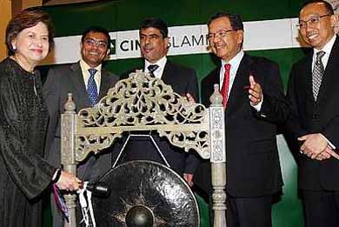
Market Education & Engagements (cont’d)
Islamic Markets
Educational Series (ETFs)
Websites & Hyperlinks
Training on Tawarruq & Commodity Murabahah
Media interviews
Speaking Engagements
Publications
MIFC Roadshows
Sponsorship
Events (Sukuk listing) e.g. IDB Sukuk
Advertising
Islamic Finance Forum i.e. in Korea with KRX
Newsletters i.e. Bursa, SC and MIFC

Slide 9
Islamic Markets
How we created our story…
Global financial crisis
Investors become more risk averse
Loss of confidence and trusts to the markets
They changed their Investment objectives from…
Capital Appreciation
Total Return
Capital Preservation
Current Income
&
&
Seeking investment opportunities offering…
Profiling
Transparency
Good Governance
By end of 2009, Bursa Malaysia become the world’s largest Sukuk listing destination with USD 17.6 billion of programme value listed through 10 issuers.

Slide 10
Sukuk Listings
The pitch was simple…
The world was experiencing a financial crisis.
Investors needed to mitigate risk.
Regulation needed to enhance good governance and transparency.
To date, Bursa Malaysia managed to attract 3 foreign Sukuk issuers i.e. GE, IDB, Nomura.
No. | Issuer | Value (USD bil)
1 | Cagamas MBS (RM) | 1,311,450,500
2 | PETRONAS Global Sukuk Ltd. (USD) | 1,500,000,000
3 | G.E Capital Sukuk Limited (USD) | 500,000,000
4 | CIMB Islamic Bank Berhad (RM) | 637,400,000
5 | Rafflesia Capital Limited (USD) | 750,000,000
6 | Cherating Capital Ltd. (USD) | 850,000,000
7 | Paka Capital Ltd. (USD) | 550,000,000
8 | Khazanah Nasional Bhd (RM) | 6,374,000,000
9 | Danga Capital Bhd (RM) | 3,187,000,000
10 | Rantau Abang Capital Bhd (RM) | 3,187,000,000
11 | Sime Darby Berhad (RM) | 1,434,150,000
12 | 1Malaysia Sukuk Global Berhad (USD) | 1,250,000,000
13 | Nomura Sukuk Limited (USD) | 100,000,000
14 | Tadamun Services Berhad (RM) | 318,700,000
Grand Total (USD) |  | 21,949,700,500
Bursa Malaysia Sukuk listings @ August 2010
% of Total Listings | 72.4 %
Global Ranking | 1

Slide 11
Bursa Suq Al-Sila’ (BSAS)
The pitch was…
Facilitating Liquidity Management
Facts on BSAS
Launched in August 2009
World’s first Shari’ah-compliant commodity trading platform
Exchange-regulated platform
From 9 to 23 trading participants
Largest daily traded: RM 2.4 billion
‘Most Outstanding Islamic Finance Product’ – KLIFF 2009
‘Market Innovation’ by Asset Triple A Awards 2010
‘Islamic Innovation Award’ by MOSTI (Ministry of Science, Technology & Innovation)
Required intensive investor education through speaking engagements by Global Head, and our Shari’ah Adviser
Cross border financing through Crude Palm Oil
Using Tawarruq concept
Internationally accepted by Shari’ah scholars

Slide 12
Bursa Suq Al-Sila’ (cont’d)
There were indeed many disputes on the issue of acceptance – until Al-Rajhi came on board.
Other GCC Banks also have followed suit.
Foreign Membership Admission
Saudi Hollandi Bank
Foreign Membership Shari’ah Approvals
1. Al Rajhi Bank
2. Alinma Bank
3. Bank AlBilad
Articles were published to increase awareness and dismiss the perception that it adopts an “Organized Tawarruq” concept

Slide 13
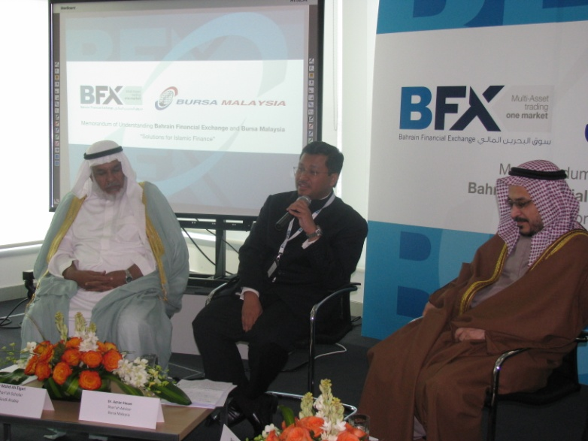
Bursa Suq Al-Sila’ (cont’d)
January this year, in Bahrain, we held a Shari'ah panel discussion entitled…
Shaping The Islamic Liquidity Management Landscape Introducing Bursa Suq Al-Sila’ :
A Regulated Commodity Trading Platform
3 Shari’ah scholars involved:
Sheikh Nizam Yaquby
Dr. Mohamed Ali Elgari
Dr. Aznan Hasan

Slide 14
Marketing Communication Plan
Advertisement in Islamic Finance Asia
Articles
Publications / Websites
Events
Sponsorship (local & international)
Speaking Engagements

Slide 15
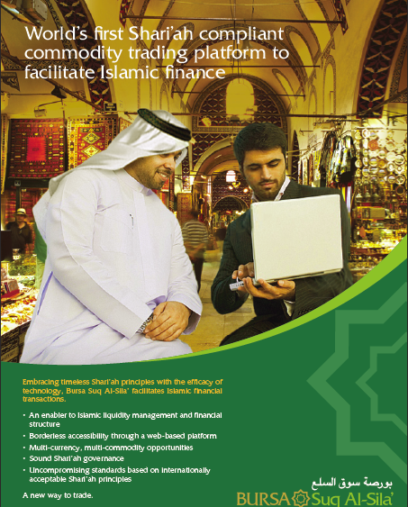
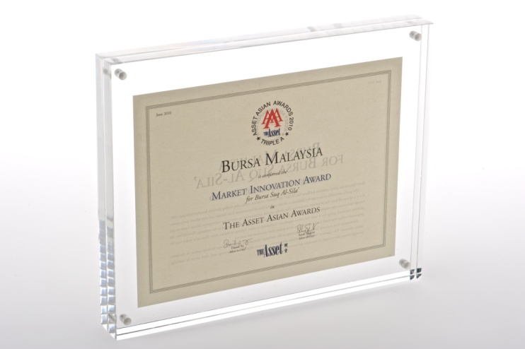
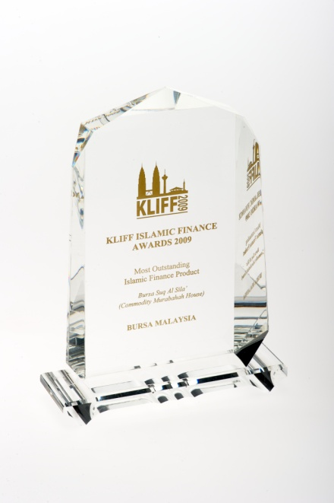
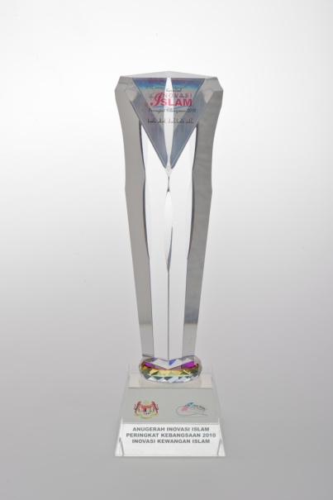
Advertisements

Slide 16
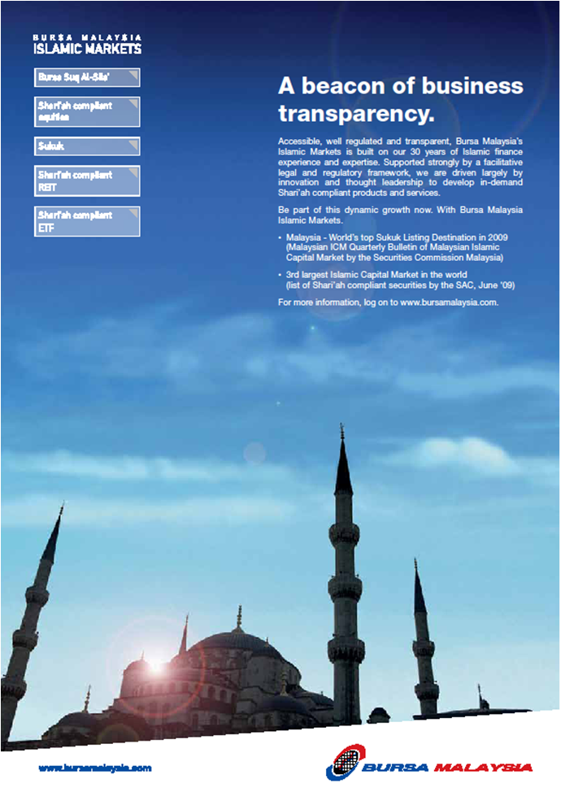
Advertisements

Slide 17
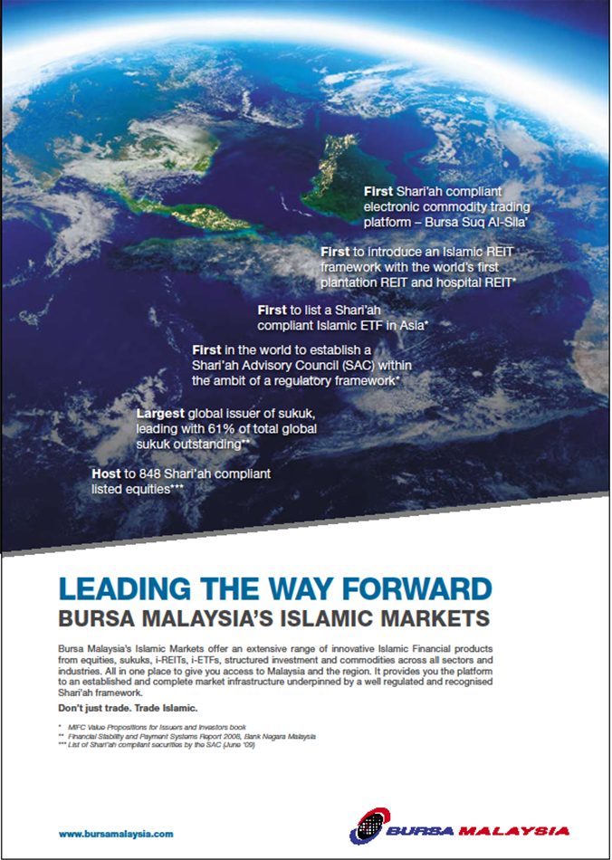
Advertisements

Slide 18
Articles
No. | Name of Article | Year
1. | Malaysian Success Stories in Islamic Finance | 2010
2. | Euromoney Sukuk Book: Chapter 1: Overview of Sukuk Market Chapter 7: Sukuk Listing | 2010
3. | Enhancing Appeal of Shari’ah-compliant Products – thorough Product Diversity and Heightened Governance & Transparency | 2010
4. | Introducing New Instruments and Developments in Islamic Finance | 2010
5. | What Makes Malaysia Attractive in terms of Islamic Finance | 2009
6. | Why Tawarruq Needs to Stay (Strengthen the practice, not rather prohibiting it) | 2009
7. | Bursa Malaysia’s Role in Developing Malaysian Islamic Capital Market | 2009

Slide 19
Publications / Websites
Islamic Sites
Islamic Finance News (IFN)
Islamic Finance Asia
Zawya
Sukuk.me
Muslims.net
Emiratesfn.com
Tradearabia.online
Global Islamic Finance Magazine
Yasaar Media
Other Financials / Wires
Reuters / Bloomberg
Malaysian Business
Asia Money
Institutional investor
Fortune
The Asset
Forbes
FTSE Global Market
Finance Asia

Slide 20
Events / Sponsorship / Speaking Engagements
Date | Event list | Venue
22 – 24 Dec 2010 | 17th Annual world Islamic Banking Conference | Bahrain
12 Nov 2010 | IFN Roadshow United Kingdom | London
2 – 3 Oct 2010 | 4th OIC stock Exchanges Forum (OIC SEF) Meeting | Istanbul
1 Oct 2010 | IFSB Seminar on Islamic Capital Market | Istanbul
3 June 2010 | Luxembourg Financial Forum | Luxembourg
24 – 25 May 2010 | 6th Annual world Islamic Funds and Capital Markets Conference 2010 | Bahrain
13 May 2010 | IFN Roadshow Hong Kong | Hong Kong
3-5 May 2010 | 7th IFSB Summit 2010 | Bahrain
30 Apr – 2 May 2010 | MIFC Roadshow to UAE and Kingdom of Saudi Arabia | Abu Dhabi, Jeddah & Riyadh
22-25 Apr 2010 | 3rd South Asian Capital Market Conference | Mauritius

Slide 21
THANK YOU
Islamic Markets
Bursa Malaysia Berhad
12th Floor, Exchange Square
Bukit Kewangan
50200 Kuala Lumpur
Tel: +60 3 2034 7000
Fax: +60 3 2072 4261
http://www.bursamalaysia.com
http://www.mifc.com
Bursa Malaysia and its Group of Companies (“the Company”) reserve all proprietary rights to the contents of this Presentation. No part of this Presentation may be used or reproduced in any form without the Company’s prior written permission.
This Presentation is provided for information purposes only. Neither the Company nor the Presenter make any warranty, express or implied, nor assume any legal liability or responsibility for the accuracy, completeness or currency of the contents of this Presentation.
It is your responsibility to verify any information before using or relying on it.

