Slide 1
OIC Member States’ Stock Exchanges Forum 10th Meeting October 27, 2016
In What Areas Can Technological Infrastructure Contribute to Development of Stock Exchanges?

Slide 2
Evolution of Business and Technology Trends
Equity Market electronic trading
BIST Business
Bills & Bonds Market electronic trading
Equity Market on
BISTECH platform
3-tier trading architecture for Bills & Bonds, Futures
1990 2000 2010 2016
FIX protocol (1992)
High-frequency trading (1999)
Technology Trends
OUCH protocol (1997)
Remote Membership
Exchange Hosting (Mid 1990s)
DMA (Direct Market Access)
Client & Server
Micro service
Architecture
CDP (Continuous Delivery Pipeline) & Automated QA Functions
Application Organization
API Connections
Three-tier Architecture
Cloud Services
(SaaS, PaaS, IaaS)
Analytics

Slide 3
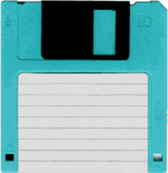
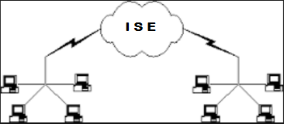
Brief History : Infrastructure Roadmap
ExAPI
Istanbul Stock Exchange (ISE) established
Batch order submission
First API connection via ISE proprietary
protocol
Order entry via FIX protocol
Borsa Istanbul (BIST) established
December
1993
July
2000
April
2013
August
2013
December
2013
December
1985
April
2000
December
2001
October
2013
Online Trading starts on the trading floor
ISE & Istanbul Gold Exchange under one roof
Turkish Derivatives Exchange starts operating under BIST
Strategic Partnership Agreement with Nasdaq
Remote access for members

Slide 4
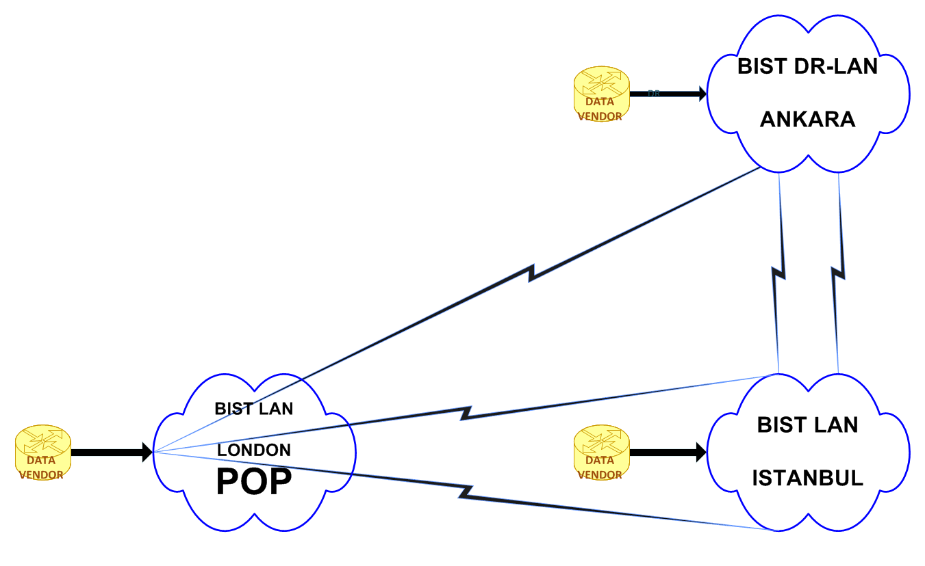
Brief History : Infrastructure Roadmap
(continued)
Equity Market opens on Nasdaq (Bistech) platform
BIST Sponsored Access / PTRM begins
OUCH service for BIST Co-location customers
Co-location services for members in BIST datacenter (FIX order entry)
Itch
Dropcopy and ITCH services for Co-lo members
January
2014
January
2015
July
2015
January
2016
2017
October
2014
March
2015
November
2015
June
2016
EDDN service begins for Sarajevo exchange
BISTECH Phase-2
Derivatives Market
Debt Securities Market
Precious Metals & Diamond Market
BIST Point of Presence (PoP) opens in London, UK
EDDN service begins for Montenegro exchange
Itch
Drop Copy service starts
ITCH service for BIST Co-location customers

Slide 5
Partnership with Nasdaq
The
Platform
Strategic partnership agreement with Nasdaq signed end of 2013
Adapting and developing high Nasdaq technology and infrastructure to suit BIST needs
Large spectrum of products from index calculation to business intelligence, marketing, etc.
Technology know-how transfer made possible
through human resource training programmes and source code access
BIST has ownership and re-selling rights throughout the region (25 countries)

Slide 6
BIST Markets Infrastructure (Before Common Platform)
BIST Markets (Silo Structure)
Equities
Trading
Data dissemination
Index calculation
Surveillance
Data Warehouse
. . .
Clearing
Settlement
(formerly) Custody
Data Warehouse
. . .
Bills and Bonds
Trading
Collateral / Risk Management
Data dissemination
Index calculation
Surveillance
Data Warehouse
. . .
Clearing
Settlement
Data Warehouse
. . .
Derivatives, F&O
Trading
Data dissemination
Surveillance
Data Warehouse
. . .
Risk Management
Settlement
Data Warehouse
...
Precious Metals and Diamond
Trading
Custody
Settlement
Data dissemination
Index calculation
Surveillance
Data Warehouse
Cash clearing
Data Warehouse
. . .
Proprietary hardware
Proprietary O/S
PL/I and C applications
In-memory database
Separate back-office
Proprietary hardware
UNIX based O/S
C applications
Relational database
Separate back-office
Proprietary hardware
UNIX based O/S
C applications
Relational database
Separate back-office
Proprietary hardware
UNIX and Windows based
Web-based app (C and JAVA)
Relational database
Separate back-office
TRADING
SETTLEMENT

Slide 7
BIST Infrastructure : Moving towards a Common Platform
(+)
Common Database
Trading
Clearing
Risk Management
Data Dissemination
Index Calculation
Surveillance
Reporting,
Business Intelligence
Settlement
Pre-trade Risk Management
Highly modular and scalable
Better investment protection due to shared and re-assignable resources
Near-homogeneous hardware and software infrastructure
Required knowledge domain more limited
Increased know-how sharing among various business units
Single database management and data sharing possible
Common modules usable by trading and settlement organizations
(-)
Underlying platform requires large number of resources due to high level of functional segregation
High homogeneity creates platform dependency and associated risks

Slide 8
BIST IT infrastructure : Capabilities
Technological Progress : BIST Trading System Performance
YEAR | 1993 | 1994 | 1995 | 1997 | 1999 | 2000 | 2000 | 2001 | 2003 | 2006 | 2008 | 2012 | 2015
Orders / sec | 3 | 5 | 13 | 25 | 39 | 77 | 124 | 239 | 478 | 550 | 2500 | 5000 | 10000
BISTECH platform
10.000 orders/sec (sustained)
100.000 orders/sec (peak)
99% of orders from FixAPI
Includes orders from co-lo customers

Slide 9
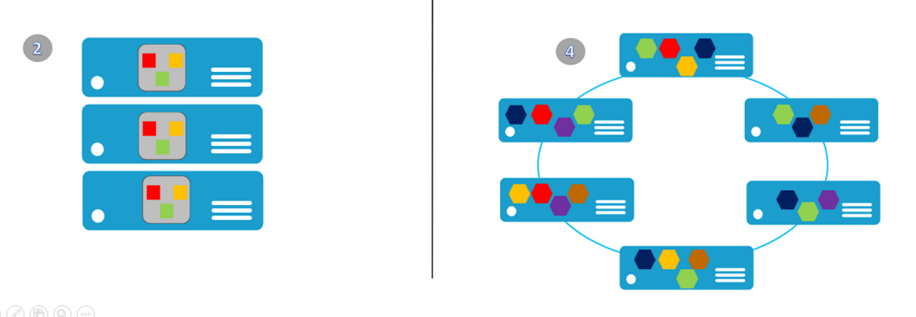
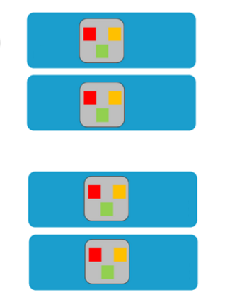
BIST Application Infrastructure Shift
Monolithic approach – One server for multiple services
Multiple dedicated servers – Separate server for each service
SERVER-1
Service-1
SERVER-2
Service-2
. . . .
. . . .
Service-n
Data
Application
SERVER-n
Application
SERVER

Slide 10
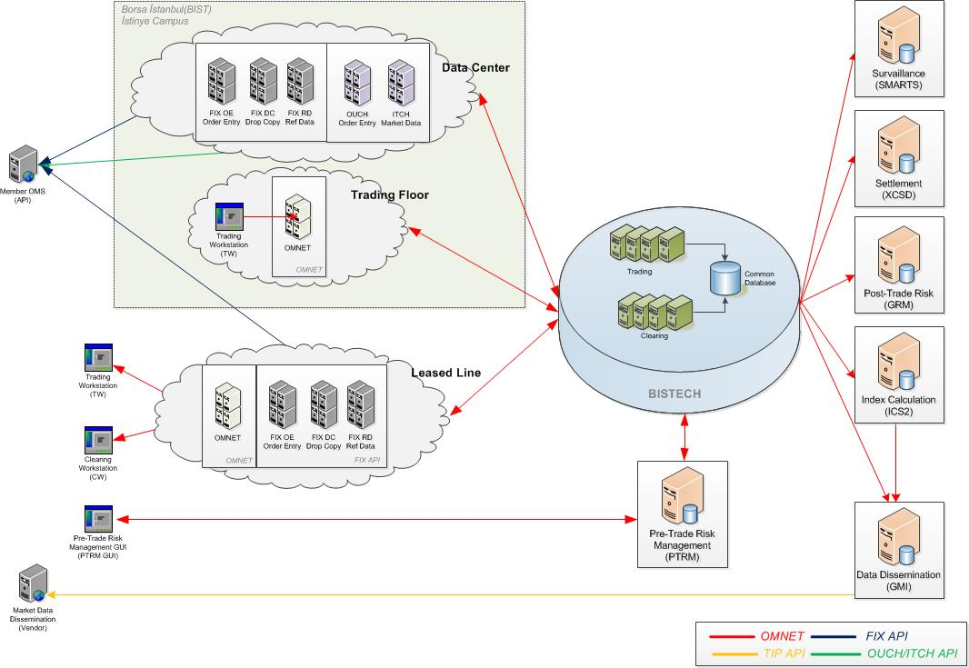
BISTECH Infrastructure

Slide 11
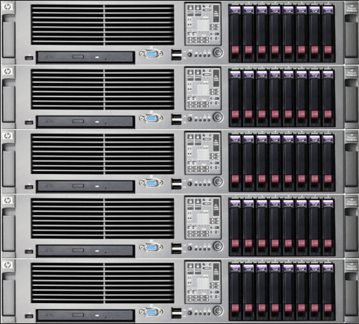
Market Systems Communications Overview
BIST Trading Floor
BIST Wide Area
Remote members connecting over the wide area
Market operations
Clearing / settlement
OMNET
10 Gbps
Load balancing over redundant links
Failover time < 3 s
FIX / OMNET
BISTECH
Servers
Data Vendors (Turkey)
Foreign Data Vendors
. . .
. . .
Data dissemination gateways & switches
BISTECH
Ring
LONDON
PoP
Co-lo gateways & switches
10 Gbps
Low-latency Switch
(port-to-port latency < 200 ns)
ITCH / OUCH / FIX
10 Gbps
Local Area Backbone
Up to 40 Gbps
NIC
APP
Members’
Servers
Member
switches
Low-latency
BIST switch
Special high-performance
NIC bypasses kernel IP
Stack for low latency
Co-location Area

Slide 12
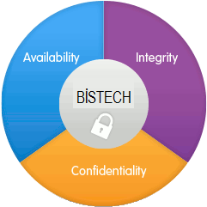
BISTECH Infrastructure – IT Security
Security Controls for
Confidentiality, Integrity and Availability of BISTECH
Periodic penetration tests and strict patch management performed
Access rights based on Segregation of Duties (SoD)
Role based system administration in place
State-of-the-art perimeter security systems implemented (FWs, IPS, anti-DOS, etc.)
Real time cyber threat monitoring
High level of network segmentation
High level infrastructure redundancy
Secure remote access methods implemented
Notes:
Accessible based on Seperation of Duties (SoD) -> Farklı kullanıcı rollerinin (PP piyasası üyesi, BAP üyesi, yazılım evi, VYK, vb.) sadece ön tanımlı yetkiler çerçevesinde BISTECH sistemlerine erişimi konusu. Bu kapsamda Kimlik Yönetim Sistemi ve FW sistemleri kullanılmaktadır.
Role based system administration in place -> Farklı BISTECH bileşenlerinin yönetimi ilgili ürün konusunda uzman olan farklı birimler tarafından gerçekleştirilmektedir. Bu nedenle sistemlere yetkisiz erişim tehditlerinin olasılığı azaltılmaktadır.
Perimeter security systems (FWs, IPS, anti-DOS, etc.) are implemented -> Dışarıdan ve içeriden gelebilecek siber tahditlerin engellenmesine yönelik farklı seviyelerde koruma gerçekleştirilmektedir.
Real time cyber threat Monitoring -> BISTECH sistemlerini siber tehditlere karşı korumak için konumlandırılan sistemlerden gelen log’lar öncelikli olarak incelenmekte ve anlamlandırılmaktadır.
High level network segmentation -> Farklı kritiklik seviyesinde olan BISTECH bileşenleri ve söz konusu bileşenlere erişen çevresel sistemler arasında ağ altyapısı ayrıklaştırma yapılmaktadır. Böylece sistemin kendi içinde beklendiği gibi çalıştığı garantilenmektedir.
Periodic penetration tests are being performed -> BISTECH altyapısı üzerinde her yıl düzenli olarak bağımsız denetim firmaları tarafından sızma testleri gerçekleştirilmektedir. Böylece olası bilgi güvenliği zafiyetlerinin önceden tespit edilmesi ve gerekli koruyucu tedbirlerin alınması amaçlanmaktadır.
Strict patch management is being performed -> BISTECH bileşenleri için yayınlanan yamalar diğer sistemlerden öncelikli olarak değerlendirilir ve uygulanır.
High level infrastructure redandancy -> BISTECH bileşenleri ve söz konusu bileşenleri destekleyen çevresel sistemler azami yedekli yapıda kurulmuştur.
Secure remote access methods are implemented -> BISTECH sistemine uzaktan (Internet, Extranet) erişimlerin güvenliği için gerekli altyapılar (VPN tüneller, two-factor yetkilendirme, vb.) hazırlanmıştır.

Slide 13
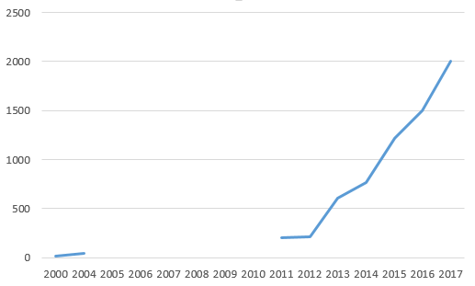
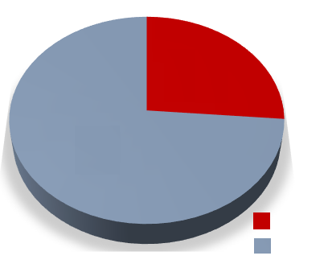
BISTECH Infrastructure – Market Servers
Physical vs Virtual Servers
Market server numbers (Physical + Virtual)
1494 servers
Physical
26%
(393 servers)
Virtual
74%
(1101 servers)
16 servers
Physical
Virtual
Numbers include all market, back office etc servers in BIST and DR site
Market production systems are all physical
Currently high level of virtualization due to numerous test and development environments
Test and development systems quickly provisioned on the virtual system pools using highly automated processes

Slide 14
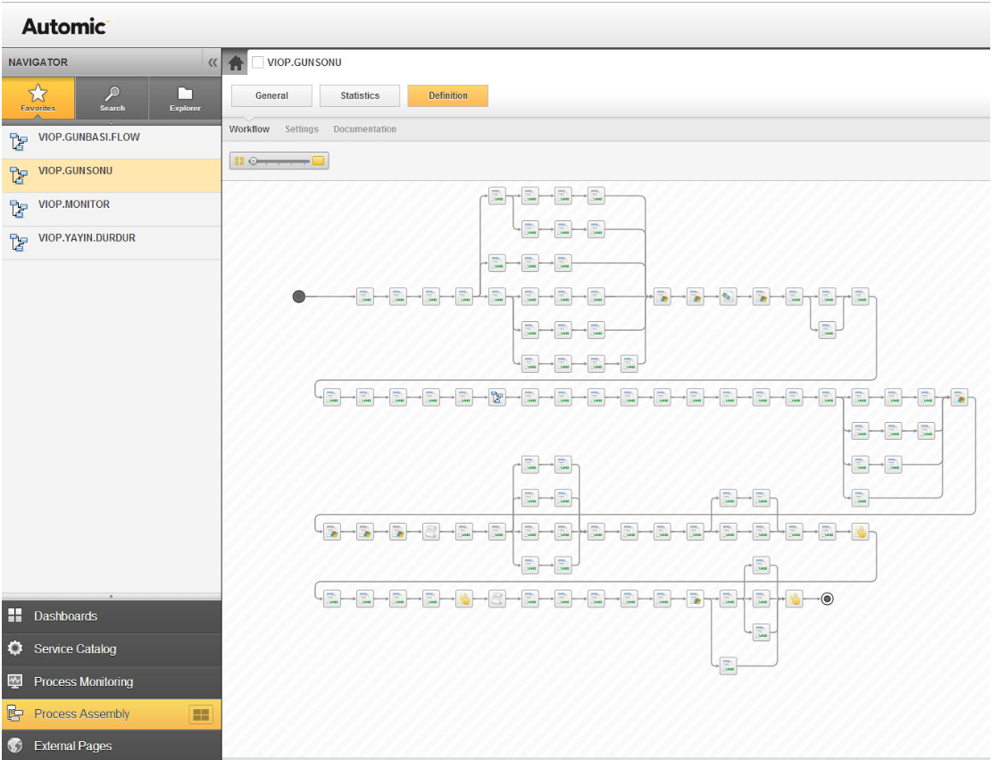
BISTECH Infrastructure – Automation
Automating day-to-day operations
Market operations automated using workload automation tool
Minimizes human errors and ensures flawless operation
Control jobs and process flow execution with conditions possible
Status easily viewed during execution
Business rules can be defined without writing code
Extensive reporting and alarm generating capabilities
Typical job flow prepared by the tool
Flexible calendar structure enables having different job flows for different dates, including custom holidays, half workdays, etc.

Slide 15
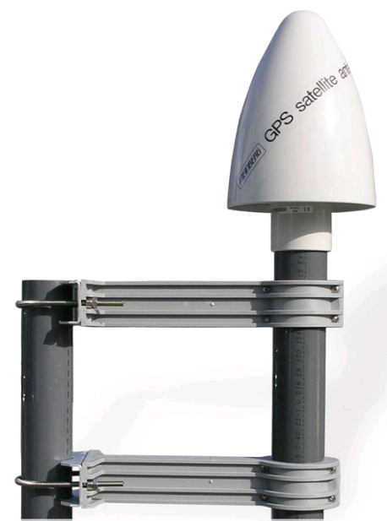
BISTECH Time Server Infrastructure
GPS satellite-1
GPS satellite-2
High-precision time-tagging and time-stamping needed for high frequency transactions
BIST established satellite time server infrastructure in 2015
Services all BIST IT infrastructure systems and devices
Global best practices implemented
Accurate time information with up to 10⁻⁷ precision
Provides NIST time
Fully redundant «time server» infrastructure with NTP and PTP support
BIST members are also provided time services

Slide 16
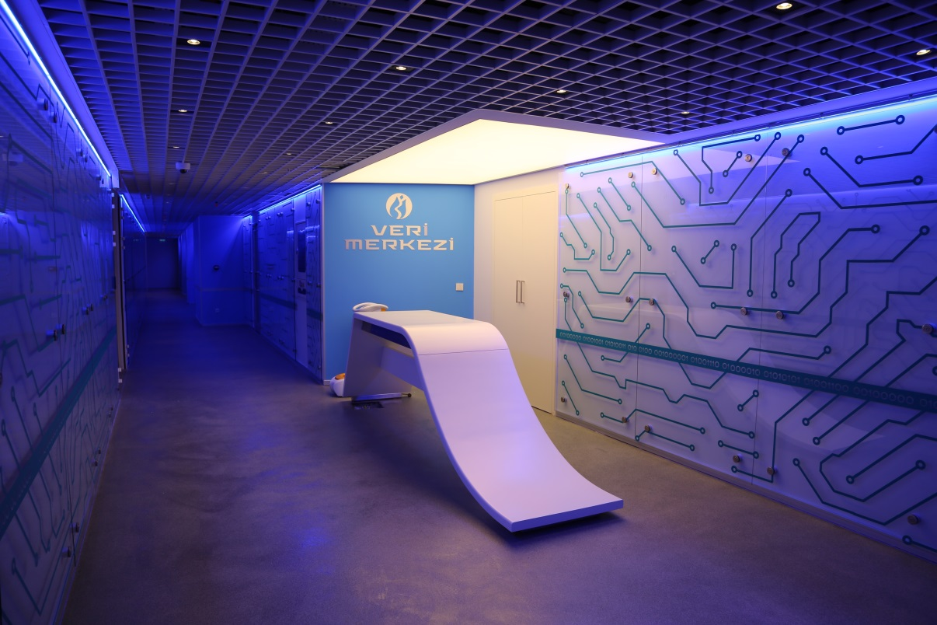
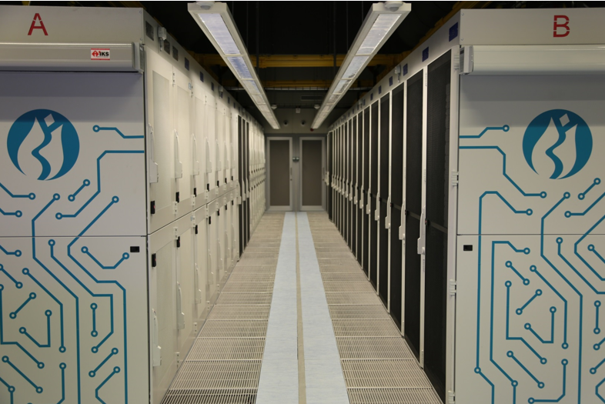
BIST Infrastructure : Datacenter Highlights
BIST datacenter hosts all IT infrastructure systems and devices of BIST, Takasbank and MKK,
as well as special areas for ISP’s, data vendors and co-located member systems
Accomodates cutting edge technology
Redundant hybrid dry coolers ensure «free cooling» during 3 months of the year
Building Management System (BMS) with 150 sensors
Fully manageble rack cabinets and PDU’s
Total area of 1.500 m² in 5 fire-resistant zones
650 m² of eathquake-proof raised floor space (white space)
High level of security
70 indoor/outdoor cameras and sensors for surveillance
Carded access system for all doors and individual rack cabinets (420 card readers)
State-of-the-art fire detection, prevention and intrusion detection systems
Highly efficient : Yearly average PUE = 1,4

Slide 17
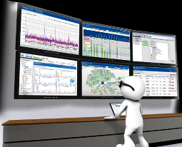
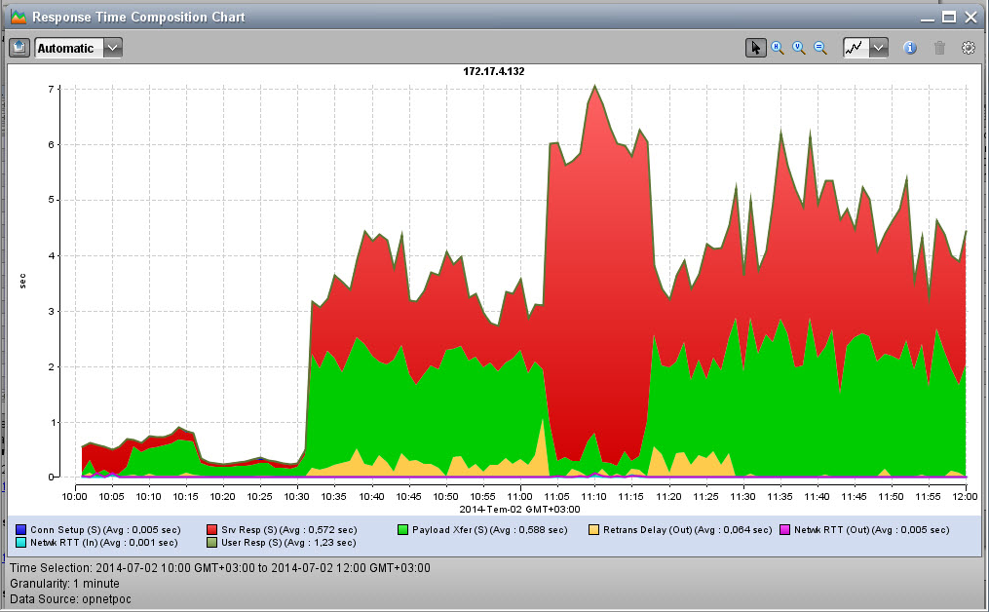
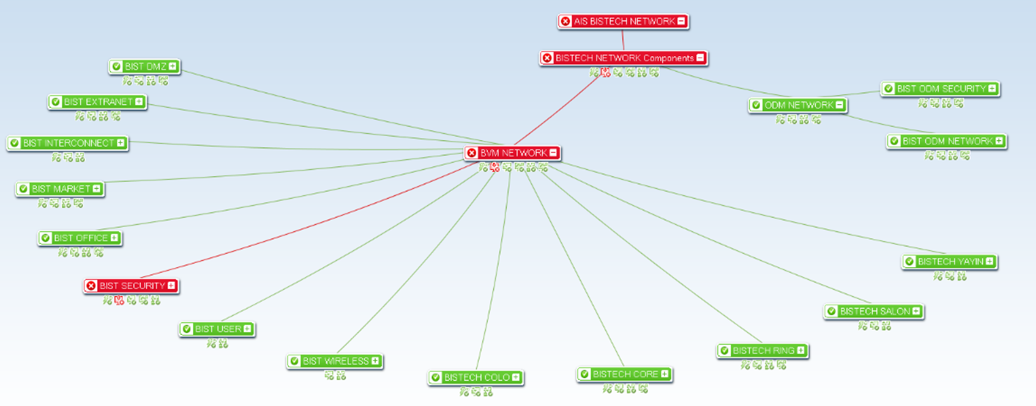
BIST Infrastructure : Monitoring
7x24 Active Monitoring
Infrastructure Monitoring
Unified console on single platform for the whole infrastructure
Server, storage and network monitoring
Agentless, low CPU consuming approach for minimum intervention to trading systems
Synthetic User Transactions
Service tree, alert correlation
Application availability monitoring
Application Monitoring
Application response time analysis and end user experience
Network traffic analysis
Anomaly detection
Troubleshooting and root cause analysis
Trend analysis
Example : Application response time analysis
A total of nearly 29.000 infrastructure elements monitored and 10.600 checks are done every minute

Slide 18
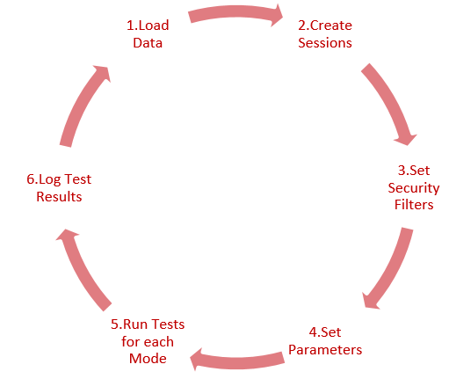
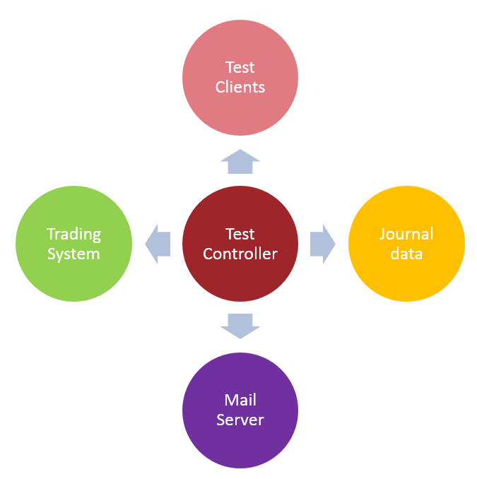
BISTECH Test Automation
BIST-developed automated market test tool enables thorough testing of applications
Test
Cycle
A whole business day’s data can be replayed in minutes
Actual order and trade data read from journal files
Test client sends data through normal market gateways
Responses compared with actual market responses
Success and failure cases reported
Enables bug-free releases for UAT (User Acceptance Test) to business teams

Slide 19
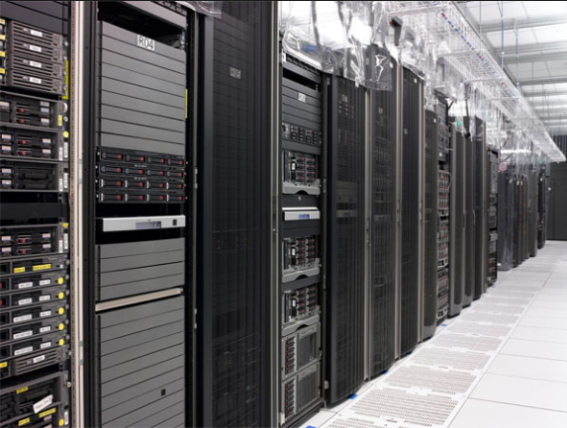
High Technology in Stock Exchange IT
How high speed trading enables business
Higher volumes
Improved system performance
Faster
Higher volumes
More opportunities
Lower cost of trading
Continuous improvement of IT
Continuous improvement of Business

Slide 20
BIST : 2017 and Beyond
Future services
BISTECH Cloud
Advanced Data Analytics
Order Entry Hub
Blockchain
Hosting services for other exchanges
New EDDN connections
Extensive use of «Continuous Delivery Pipeline» approach

Slide 21
Thank You…

