Slide 1
Developing Markets for Islamic ETFs and Depositary Receipts
Presented at
OIC Member States’ Stock Exchanges Forum 10th Meeting
Istanbul, Turkey.
October 27, 2016
Jahangir Sultan
Bentley University
and
Marblehead Investment Partners, llc
Marblehead, Massachusetts

Slide 2
Promoting Islamic Investment Products
Attract foreign investment increased product development
Macro investing
Creating ETFs representing an index
Micro investing
Investing in firm-specific DRs
Challenges and opportunities

Slide 3
ETFs
Open ended mutual funds that trade like stocks
ETFs represent stocks, bonds, currencies, country index, commodities, gold, etc.
Some are passive (indexed) while others are active -- ‘smart beta’ ETFs
Transparency: NAV of underlying basket of shares reported daily

Slide 4
Trading ETFs
Buyers
Stock Exchange
Authorized
Participants
ETF
(Fund)
Sellers

Slide 5
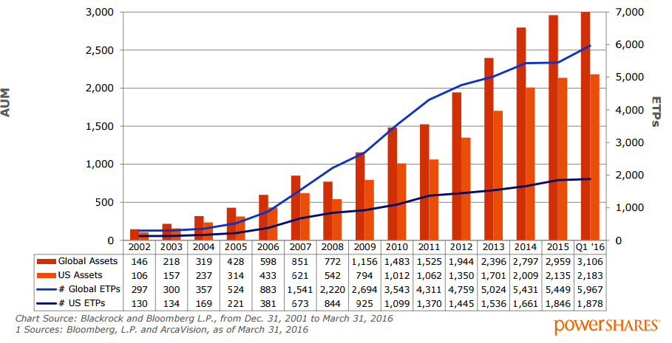
Market cap of ETF’s from 2002 - 2016
Invesco

Slide 6
Why invest in ETFs
Participate in the full index
Portfolio management style (factor investing); style consistency
Being able to trade anytime when the stock market is open
Low costs because of lower management fees
Potential for diversification

Slide 7
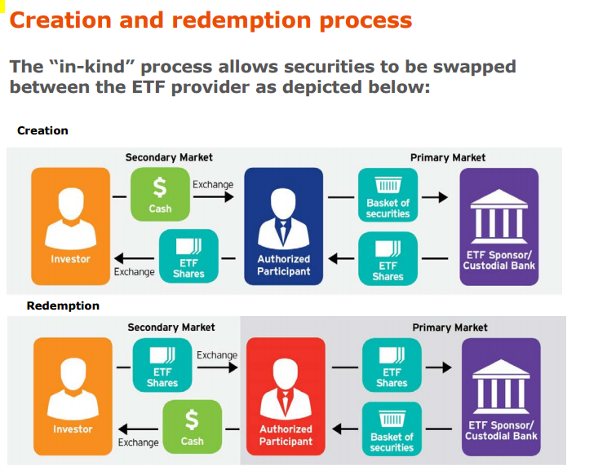
Invesco

Slide 8
ETF underlying basket selection
Physical -- Full replication of the index (identical replica)
Buy shares that are included in the index with the same weightings
Most transparent; Low tracking error; too many stocks to buy; Not very efficient (costly)

Slide 9
ETF underlying basket selection
Physical – Stratified Sampling
Buy shares of largest index members (liquid stocks).
Buy reduced number of smaller companies that mimic the index. Rebalancing is easy; Tracking errors might be higher; Not very transparent

Slide 10
ETFs- alternative weighting
Selections
Rules based quantitatively optimized
Instead of cap weighting
Factor based
Factors could be fundamental/economic factors
firm-specific

Slide 11
Core and satellite approach
Core ETF
Sector
Global
Multi factor
Style
Derivatives
Core is a diversified strategy based on an index
Satellite are different tilts (opportunistic) to add exposure and enhance returns

Slide 12
Islamic and Conventional ETFs: Differences
Islamic ETFs include SC stocks
Benchmark index is SC
Diversification benefits are lower with Islamic ETFs because many sectors/stocks are excluded
Risk is lower
Excludes derivatives
Risk management of ETFs is very limited
Does not allow securities lending, shorting, or swaps

Slide 13
Size of Islamic ETF Industry and performance
Shariah-compliant equity ETFs listed globally in 10 countries, including Malaysia, Saudi Arabia and Turkey added up to $1.23 billion (Global Finance, July 2014)
Alam (2013) finds Islamic ETF outperformed conventional ETFs (2008-2011) –small sample
Lackluster performance in other cases

Slide 14
Islamic ETF providers --perspectives
Perspectives on growth
ETFs issued from Western economies
Slow growth
ETFs issued from Eastern economies
Slow growth;
Demand side
Supply side
Performance

Slide 15
Slow Growth of Islamic ETFs – exposure
Developed country ETFs have less than 1% exposure to Islamic countries. Islamic countries are not well represented in Sharia compliant universe of stocks (ISWD MSCI world exposure is about 94% (US and developed economies)
Does not really promote developing /emerging countries –capital markets in these countries remain illiquid

Slide 16
Why slow Growth of Islamic ETFs –
Most faith based ETFs are experiencing slow growth
Not just Islamic ETFs
Some Islamic ETFs have closed after a brief period of existence
Christian ETFs are also having similar issues
Compared to that SRI/ESG/Gender/Environment issues are doing better

Slide 17
Slow Growth of Islamic ETFs – track record
Islamic ETF providers may not have the track record.
Javelin (JVS) had no previous experience in managing a fund

Slide 18
Slow Growth of Islamic ETFs – identity crisis
Low favorability of faith based investment products in general
Negative perception of Islam and Sharia in the West.
Unfamiliarity with Islamic ETFs among investors -
Not on the radar screens of investment advisors

Slide 19
Slow Growth of Islamic ETFs –performance
By definition, Islamic ETFs may not outperform the underlying index
Often less than full replication
Remaining basket not representative of the index
Further reduction in coverage due to Sharia screening of negative stocks
So, are we expecting a lot?

Slide 20
Slow Growth of Islamic ETFs – illiquidity
Low trading volume of underlying shares
High bid-ask spread
Difficult to exit with fair prices
Creation and redemption help -- but tough to unload large number of shares (Mahdzir Othman, i-VCAP)

Slide 21
Slow Growth of Islamic ETFs – cash drag and timing issues
Cash Drag: When dividends are distributed by underlying shares, distribute to ETFs on a real time basis. Should reduce cash drag and tracking error
Timing: If index reconstitutes, the rebalancing of the ETF should be done quickly to reduce tracking error.

Slide 22
Slow Growth of Islamic ETFs – short selling
Since, trading alternatives such as short selling is not available in Islamic ETFs, they tend to be less attractive for non-Muslim individuals or institutional investors with mandates for risk management
For Muslim investors, this is not an issue

Slide 23
Islamic ETFs: lack of product diversity
Islamic ETFs have a single focus – Sharia compliant large/mid-cap stocks
Not enough attention to SRI/ESG/governance themes
Raja Teh Maimunah, head of Islamic markets at Bursa Malaysia --the lack of diversified products was one shortcoming of the industry compared to its conventional peers.

Slide 24
Slow Growth of Islamic ETFs – support system
Since these ETFs have low trading volume, they have trouble exciting market makers
Unlike mutual funds (with dedicated distribution agents), dealers and agents of ETFs do not charge commission.
ETF providers can only charge very low management fees. (Mahdzir)

Slide 25
Problems with Islamic ETFs- government support
Should governments support Islamic ETFs?
Why should government be involved in helping out Islamic ETFs when non-Sharia ETFs are left to fend for themselves
Governments should create a fair and consistent standards for all. UK FSA – no obstacle, no special favors –level playing field.. Financial regulator, not a religious regulator

Slide 26
Problems with Islamic ETFs- government support
There is a role for sovereign wealth funds for supporting Islamic ETFs issued in their country.
But sovereigns buying Western economies-based ETFs does not benefit the industry or the constituents which are from Islamic countries.
“If Islamic ETFs are going to take hold globally and specifically in the Middle East, there has to be government, or quasi-government support, through sovereign wealth fund participation in the market” (Source : Islamic Finance Asia)

Slide 27
Soft support
Rebranding? Controversial but may be prudent
Improve image of Islam in Western economies
How?
Investor education; roadshows in Islamic and Western economies – connecting with Islamic centers in large cities to highlight benefits of Islamic ETFs
Providing research and training support; webinars; educational seminars

Slide 28
Conclusions
Islamic ETFs investors do not have to sacrifice returns for subscribing to faith
Islamic ETFs should be attractive to non-Muslim investors for their performance.
Overly aggressive optimization should be avoided to reduce tracking error
Investor familiarity with ETFs should be improved
SECs should set up uniform standards for issuing ETFs

Slide 29
Depositary Receipts

Slide 30
Depositary Receipt (DR)
A stock that trades in the domestic stock exchange but represents a specific number of shares in a foreign stock
Traded like stocks
Issued/sponsored by a domestic bank or brokerage
Notes:
DR stands for “American Depositary Receipt”
It is a stock that trades in the US but represents a specific number of shares in a foreign corporation
DRs are bought and sold on American markets and are issues/sponsored in the US by banks or brokerages

Slide 31
Mechanics of Depositary Receipts (DRs)
Depositary Receipts
issued by a bank representing
underlying shares held
by a custodial bank
Shares
Receipts
(DRs)
Publicly traded foreign firms
Receipts for shares
listed on home exchange
Traded by
home investors
Shares traded on foreign
stock exchange
Shares
Arbitrage
Activity

Slide 32
Three Types of DRs
Level 1: Foreign companies either don't qualify for listing on an exchange
OTC; loosest requirements from the SEC
Level 2: Listed on an exchange or quoted on Nasdaq
Filing requirements; higher visibility trading volume
Level 3: Capital raising; high quality
Notes:
There are three types of DR issues.
Level 1 is the most basic type of DR where foreign companies either don’t qualify or don’ wish to have their DR listed on an exchange. Level 1 DRs are found on the over-the-counter market and are an easy and inexpensive way to gauge interest for its securities in North America. They also have the loosest requirements from the Securities and Exchange Commission.
Level 2 is listed on an exchange or quoted on Nasdaq. They have slightly more requirements from the SEC, but also get higher visibility trading volume
Level 3, which is the most prestigious of the three, this is when an issuer floats a public offering of an DR on a US exchange

Slide 33
Sponsored vs Unsponsored DRs
Sponsored
Supply driven
Deutsche creates a DR on behalf of a foreign company for a fee
Represents legal relationship between Deutsche and the foreign company
Trade on NYSE/NASDAQ; full voting rights
Unsponsored
Demand driven
Trade on OTC; no voting rights

Slide 34
Risks of DRs
Political Risk
Is the government of the DR’s home country stable?
Exchange Rate Risk
Is the currency of the home country stable?
Inflationary Risk
Extension of exchange rate risk
Notes:
Several factors determine the value of the DR, other than just the performance of the company. Investors should consider three important risks, in addition to the company’s fundamental performance.
1.) Political risk – Is the government of the DR’s home country stable?
- Example: May be cautious about Russian Vodka, Inc. because of Russia’s instability
2.) Exchange rate risk – Is the currency of the home country stable?
- DR shares track the shares in the home country. If the home country’s currency is devalued, it will affect the DR. This can result in big loss, even if the company performs well.
3.) Inflationary risk – Extension of exchange rate risk
- Inflation, the rate at which the general level of prices for goods and services is rising and purchasing power is falling, can cause problems for a company. The currency of a country with high inflation becomes less and less valuable.

Slide 35
Marketing DRs --Listing
Most often cited reasons for listing DRs
Reducing the stake held by existing shareholders
Improving liquidity and broadening the shareholder base
Capitalizing on the product market reputation
Fees
Lowering cost of capital
External image
Promote price discovery

Slide 36
Investors benefits from DRs
For individuals, DRs are an easy, cost-effective way to buy shares in a foreign company
Country exposure
Foreign exchange exposure
Firm-specific exposure
Investing in industries that are absent in home country
Non-systematic risk should be higher
International diversification would be greater
Notes:
The advantageous of DRs are twofold:
For individuals, DRs are an easy and cost-effective way to buy shares in a foreign company. They save money by reducing administration costs and avoiding foreign taxes on each transaction
Foreign entities like DRs because they get more U.S. exposure, allowing them to tap into the wealthy North American equities markets

Slide 37
Who are the Investors in DRS?
Institutional investors dominate the DR market, accounting for 72% of all holdings.
They possess significant advantage in accessing, acquiring, processing information.
A significant part of this pool is involved in high frequency trading and quantitative portfolio optimization.

Slide 38
Islamic DRs
Select DRs by applying Sharia screening
Restricted universe because of negative screens
Apply the DJIM index as a benchmark
Single stock DRs
Allow faith based investing and foreign diversification

Slide 39
The universe of DRs in this study
S&P Dow Jones Islamic
S&P Dow Jones Global
S&P Dow Jones SRI (Socially responsible DRs and ESG)
Passive – min-variance optimization
Performance indicator – Sharpe, MSR, Sortino
Constituents provided by S&P Dow Jones

Slide 40
International portfolio diversification – Islamic DRs or their underlying stocks
Compare international portfolio diversification with DRs and their underlying foreign stocks
– which is better?
Four regimes
2003-2014
Pre-crash (2003-Feb 2007)
Crash (2007 (March) – 2009 (April)
Recovery (2009 (May) – 2014 October)
Notes:
In the backdrop of the global financial and economic crisis, our study strived to determine whether an investment philosophy for mutual funds in accordance to Islamic finance principles would have resulted in risk-adjusted return improvements. An Islamic investment strategy might have proven especially beneficial due to its exclusion of highly leveraged companies and emphasis on high-level asset backing.
Using quantitative analysis, we will compare the performance of equity portfolios devised according to Islamic, Socially Responsible Investing, short SRI, and Traditional asset allocation methodologies

Slide 41
Performance* of Islamic DRs
Regimes DR portfolio rank
2003-2014 1
Pre-crisis 2
Crisis 2
Post-crisis 1
*Based on risk adjusted returns
* Underlying portfolios perform similar
Notes:
In the backdrop of the global financial and economic crisis, our study strived to determine whether an investment philosophy for mutual funds in accordance to Islamic finance principles would have resulted in risk-adjusted return improvements. An Islamic investment strategy might have proven especially beneficial due to its exclusion of highly leveraged companies and emphasis on high-level asset backing.
Using quantitative analysis, we will compare the performance of equity portfolios devised according to Islamic, Socially Responsible Investing, short SRI, and Traditional asset allocation methodologies

Slide 42
The Universe
 |  |  | DR Universe
Category |  | GLOBAL | ISLAMIC | SRI | Grand Total
144A |  |  |  | 3 | 3
LEVEL I |  | 110 | 82 | 46 | 238
Sponsored |  | 66 | 64 | 39 | 169
Unsponsored |  | 44 | 18 | 7 | 69
LEVEL II |  | 21 | 30 | 12 | 63
LEVEL III |  | 20 | 12 | 16 | 48
Grand Total |  | 151 | 124 | 77 | 352
 |  |  | Underlying Stocks*
 | 151 |  | 124 | 77 | 352
Each DR was matched by its corresponding underlying stock

Slide 43
Diversification with DRs and underlying stocks (2003-2014 (October)
 | DR Portfolio
Category | Return | Risk | Tracking Error | Number of stocks | MSR | Downside risk | Excess Return | Sortino | MSR Ranking
Islamic DR | 7.31% | 11.64% | 1.83% | 20 | 32.92% | 1.29% | 0.02% | 0.02 | 1
Global DR | 6.18% | 10.70% | 2.03% | 27 | 25.21% | 1.43% | 0.00% | 0.00 | 2
SRI DR | 6.18% | 15.27% | 1.63% | 23 | 17.67% | 1.18% | 0.00% | 0.00 | 3
 | Underlying Stock Portfolio
Islamic Stocks | 7.43% | 11.90% | 1.92% | 20 | 33.16% | 1.36% | 0.02% | 0.02 | 3
Global Stocks | 9.41% | 10.81% | 2.04% | 27 | 54.86% | 1.40% | 0.06% | 0.04 | 1
SRI Stock | 9.97% | 15.50% | 1.73% | 23 | 41.87% | 1.20% | 0.07% | 0.06 | 2

Slide 44
Diversification with DRs and underlying stocks: Pre-crisis (2003-2007 (Feb))
 | DR Portfolio
Category | Return | Risk | Tracking Error | Number of stocks | MSR | Downside risk | Excess Return | Sortino | MSR Ranking
Islamic DR | 12.84% | 9.57% | 1.40% | 20 | 88.29% | 1.01% | 0.03% | 0.03 | 2
Global DR | 11.70% | 10.03% | 1.51% | 27 | 72.89% | 1.06% | 0.01% | 0.01 | 3
SRI DR | 17.08% | 11.67% | 1.43% | 23 | 108.81% | 0.97% | 0.11% | 0.11 | 1
 | Underlying Stock Portfolio
Islamic Stocks | 13.07% | 9.48% | 1.44% | 20 | 91.62% | 1.02% | 0.03% | 0.03 | 3
Global Stocks | 14.58% | 9.96% | 1.53% | 27 | 102.37% | 1.04% | 0.06% | 0.06 | 2
SRI Stock | 20.22% | 11.77% | 1.54% | 23 | 134.49% | 1.02% | 0.17% | 0.17 | 1

Slide 45
Diversification with DRs and underlying stocks: Crisis (2007 (Mar)-2009 (Apr)
 | DR Portfolio
Category | Return | Risk | Tracking Error | Number of stocks | MSR | Downside risk | Excess Return | Sortino | MSR Ranking
Islamic DR | -12.04% | 17.26% | 2.70% | 20 | -2.71% | 1.88% | 0.22% | 0.12 | 2
Global DR | -5.58% | 15.20% | 3.04% | 27 | -1.41% | 2.00% | 0.35% | 0.17 | 1
SRI DR | -18.20% | 24.23% | 2.30% | 23 | -5.30% | 1.66% | 0.11% | 0.06 | 3
 | Underlying Stock Portfolio
Islamic Stocks | -11.67% | 18.08% | 2.89% | 20 | -2.77% | 2.02% | 0.23% | 0.11 | 2
Global Stocks | -2.74% | 15.52% | 3.08% | 27 | -0.99% | 2.03% | 0.40% | 0.20 | 1
SRI Stock | -13.27% | 25.10% | 2.46% | 23 | -4.25% | 1.70% | 0.20% | 0.12 | 3

Slide 46
Diversification with DRs and underlying stocks: Post-Crisis (2009 (May)-2014 (October)
 | DR Portfolio
Category | Return | Risk | Tracking Error | Number of stocks | MSR | Downside risk | Excess Return | Sortino | MSR Ranking
Islamic DR | 10.88% | 10.07% | 1.67% | 20 | 81.62% | 1.19% | -0.06% | -0.05 | 1
Global DR | 6.72% | 8.84% | 1.85% | 27 | 46.00% | 1.40% | -0.14% | -0.10 | 2
SRI DR | 7.70% | 12.69% | 1.44% | 23 | 39.78% | 1.08% | -0.12% | -0.12 | 3
 | Underlying Stock Portfolio
Islamic Stocks | 10.80% | 10.23% | 1.74% | 20 | 79.62% | 1.25% | -0.06% | -0.05 | 2
Global Stocks | 10.36% | 8.94% | 1.84% | 27 | 86.20% | 1.34% | -0.07% | -0.05 | 1
SRI Stock | 11.53% | 12.57% | 1.50% | 23 | 70.59% | 1.08% | -0.05% | -0.05 | 3

Slide 47
Diversification with DRs
DR and UL portfolio returns are very similar --no statistical differences in the returns
Directional diversification strategy (DR to UL or UL to DR) yield similar results
Indication of maturity of the markets – especially for cross-listed stocks
Stocks with DRs perform similar – important feed back effects --

Slide 48
Diversification with DRs
Islamic DR portfolio has the best performance for post-recovery period
Islamic UL portfolio performs very similar
During financial crisis, Islamic portfolios were effective in preserving value – not as effective as global portfolio
SRI portfolio had the worst performance during the crisis

Slide 49
Depositary Concerns
Poor liquidity-DRs and underlying
Large cancellation reduces business; cancellation/conversion fees discourage flow
How to encourage investors to stay engaged with DRs
The effects of corporate actions on trading volume
Sanctity of financial statements
Do brokers understand risks?

Slide 50
Broker Concerns
Poor liquidity-DRs and underlying
Market price; execution delays
Cancellation/conversion fees discourage flow
Inventory -- Books open?
Cross-border settlement delay; infrastructure
The effects of corporate actions on trading volume
Sanctity of financial statements

Slide 51
Issuer Concerns
Poor liquidity-DRs
Investor appetite; investor participation
Marketing; reputation of the depositary institution
Regulatory environment
Image of the firm among Institutional investor;

Slide 52
Western perceptions
Regulatory barriers –repatriation of capital
Liquidity; breadth; depth
Familiarity with OIC countries
Familiarity with Islamic theme based investments
Not visible in world capital markets
Low volume in Islamic products
Not enough marketing of OIC products

Slide 53
Perceptions about Islamic finance products
Lack of standardization of Sharia principles
Lack of risk management instruments
Enforcement of legal rights across markets
Very limited appetite for Islamic products among HNW investors

Slide 54
Conclusions
Possible to discriminate among various stock universes to identify disparate investment strategies
There is room for both values and profit motivated investment strategies for these stock universes
SC universe has unique appeal to those demanding SC compliance as well as profitability

