Slide 1
Islamic Rating Standards
&
Stronger Capital Markets in OIC
Faheem Ahmad, Sept., 26, 2019

Slide 2
Size of the Global Capital Markets & Regulatory Regime on Ratings

Slide 3
Size of the Global Debt Market

Slide 4
Size of the Global Equity Market

Slide 5
Global Rating Canvas

Slide 6
S&P’s Rated Universe

Slide 7
Why Credit Ratings?
Higher ratings help access to funds at lower
margins, lower transaction costs
Quick approval time
Faster disbursement of funds
Documentation of economy
Cross border transaction enabled
Infrastructure funding support
Simplify lending
Collateral may also be relaxed
Integration into SDG a project
implantation (UNPRI)
Information asymmetry reduced
Capital market access
Long term funds available
Price discovery
Mutual & pension funds, insurance, NBFCs
investments enabled
Facilitate SMEs to access credit
(Bangladesh, India)

Slide 8
Global Regulatory Support for Ratings!
USD is the biggest Reserve Currency >60% Central Banking Reserves, therefor BIG3 Emerged
Global Standard Setting Bodies Enable Credit Ratings
BIG3 Enabled in Basel II/III for Capital Requirements Calculations
Ratings are Required by Regulatory Framework & Investors for pricing and trading on Listed Issues
Sheer Size of the Markets need Ratings for Stability
Global Pension Funds, Insurance, Financial Institutions, Corporates and International Individual Investors depend on the Bond Market for regular Income Streams thus Reliance on Ratings is Universal and the Debt Market is the Backbone of an Economy

Slide 9
Shari’ah Aspects in Global Credit Rating Agencies Methodology

Slide 10
Do GCRAs Incorporate Shari'ah Principals in their Ratings?
Fitch Updated Sukuk Rating Criteria 22 JUL 2019 on Fitch's approach to assigning and maintaining ratings for new and existing originator-backed Sukuk issues:
Fitch's analytical assumption under these criteria is that the structure of the Sukuk and the underlying transaction(s) provides for full recourse to the originator - as with a conventional bond issue - and the Sukuk rating is driven solely by the originator's rating
Ratings assigned to Sukuk do not imply any confirmation that the Sukuk are sharia compliant. Fitch will assess non-compliance with sharia if it has credit implications
Similar International Criteria adopted by S&P and Moody’s

Slide 11
IIRA’s Methodology on
Shari’ah Aspects

Slide 12
IIRA, The Only Rating Agency Promoting Islamic Finance..
IIRA as one of the 8 Infrastructure Institutions of IDB, has been mandated to incorporate Shari’ah Aspects into Its Credit Ratings
Established by IDB in Bahrain to Promote Islamic Finance and became Operational in 2005
IIRA has ratings in more than 15 OIC Countries
It has Regulatory Recognition in 7 OIC Jurisdictions
Issuing Fiduciary/Shari’ah Governance Ratings since 2012
OFFICES/Rep Offices:
Bahrain, Sudan, Pakistan, Astana, Morocco
Istanbul (Subsidiary is being established)
Other Group Offices:
Iran, Bangladesh, Malaysia

Slide 13
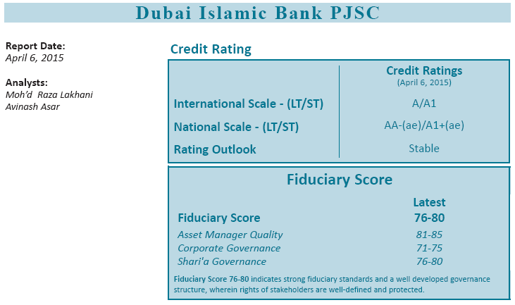
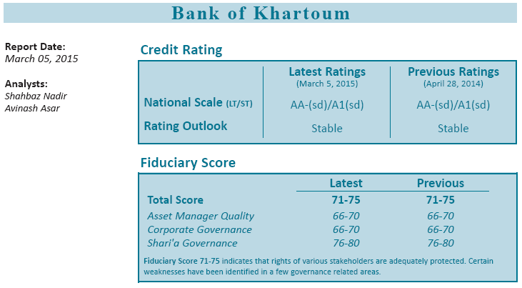
Comprehensive Fiduciary Rating Criteria on Issuer/Issues
Facilitate Development of Sukuk markets through National Scale Ratings
IIRA’s Fiduciary Ratings appealing to varying needs of investors, with greater information for investors regarding institutional strength, in addition to governance capabilities, while giving specific coverage to Shari'ah Governance

Slide 14
IIRA’s Strategy is Creating a Difference

Slide 15
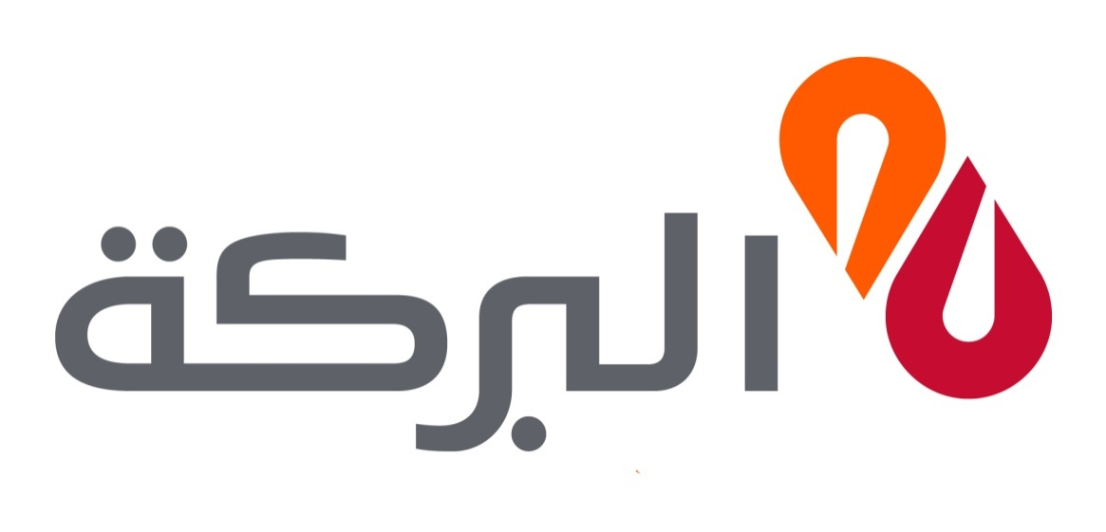
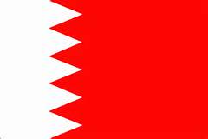
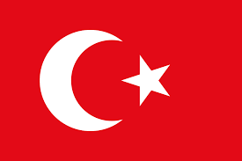
Leading Market Players have engaged IIRA for Ratings
شركة البركة للتأمين المحدودة

Slide 16
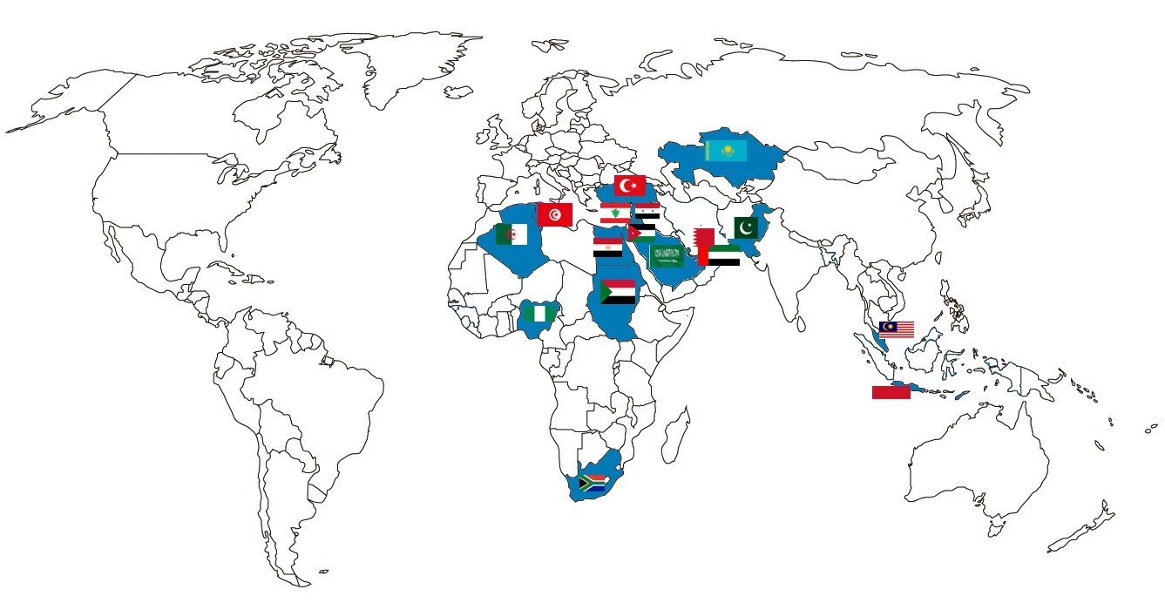
IIRA’s Footprint is expanding in OIC Markets

Slide 17
Shari’ah Governance Ratings Standards

Slide 18
Steps by Standard Setting Bodies in Islamic Finance..
AAOIFI Setting Standards on Ratings:
Standard Setting Bodies (AAOIFI) has Issued a New Standards on Shariah Compliance & Fiduciary Ratings (Standard GSIFI 10)
This will help in Developing Islamic Finance and The Sukuk Markets

Slide 19
Need for Expanding the OIC Capital Markets

Slide 20
Size of Islamic Finance… It’s Importance
Report (April 2019) by IMF:
It highlights key challenges facing the Islamic Financial Industry. Islamic Banking (IB) has grown rapidly in value and geographical reach, and has become an important and integral part of the financial systems in many countries.
Though IB accounts for less than 2 percent of global finance, IBs currently operate in more than 60 countries and the industry has become systemically important in 14 jurisdictions

Slide 21
An Initiative to Deepen OIC Capital Markets

Slide 22
OICEF Could Help in Deepening Islamic Capital Markets…
A Project could be Initiated to Enable Cross-Border Listings of Institutions/Sukuk to Accelerate Capital Market Growth in OIC
The Benefits for Listed Institutions/Sukuk would be several, few of them would be:
Improved image, reputation and prestige as a significant player in the OIC markets
Greatly expand the ability to raise equity or Sukuk financing with new funders and Investor base
Increased trading volume and liquidity

Slide 23
OICEF Could Help in Deepening Islamic Capital Markets…
Cross-Border Listings Contd.…..
Improved shareholder relations and New Potential Shareholders Identified
Vastly enhance visibility among overseas investors and consumers
Tap into OIC retail and institutional funds

Slide 24
OICEF Could Help in Deepening Islamic Capital Markets…
Few Important Areas of Standardization for “Like Exchanges Network”:
Float Size/Sukuk Size, Market Cap
Track Record, Prospectus Standardization
Corporate Governance, Yearly reporting, Financial reporting
Taxation
Listing Cost and Yearly Expenses
Shariah Governance & Rating Requirements
These Listings Could be enabled on a Separate Platform Network to Accelerate the Process under a Central Clearing System

Slide 25
OICEF Could Help in Deepening Islamic Capital Markets…
Differences between admission criteria and continuing obligations for AIM the main Market , London Stock Exchange
AIM
No minimum market capitalization
No trading record requirement
No prescribed level of share to be in public hands
No prior shareholder approval for transactions
Nominated advisor required all time
Yearly up-dates availability on website
Tax Relief Available
Admission documents not pre-vetted by the exchange or by the UKLA is most circumstances. The UKLA will only vet an admission documents where it is also a prospectus under the prospectus directive
Main Market
Minimum market capitalization
Normally three-years trading record required
Minimum 25 per cent share in public hands
Annual Filing Required
Prior shareholder approval required for substantial acquisitions and disposals (premium lasting only)
Standard Tax Applicable
Sponsor needed for certain transactions (Premium list only)
Pre-vetting prospectus by the UKLA

Slide 26
OICEF Could Help in Deepening Islamic Capital Markets…
Frankfurt Stock Exchange has an Open Market Platform for easy Listings:
Similar Enabling Regulations are offered by The Open Market on the FWB Frankfurt Stock Exchange which trades German and foreign shares, fixed income securities of German and foreign issuers, as well as funds, certificates and warrants. Shares from more than 60 countries are included in this trade.
It Maintains a list of “Like Exchanges” from where Dual Listing could be accomplished in a very Short-Period and with low Cost.

Slide 27
Thank You

