Slide 1
Sustainability and Islamic Capital Markets Mahmut Aydoğmuş

Slide 2
Flow of Presentation
Sustainable Finance
Sustainability Principles for Exchanges
Islamic Capital Markets and Sustainability
Borsa Istanbul Sustainability Efforts

Slide 3
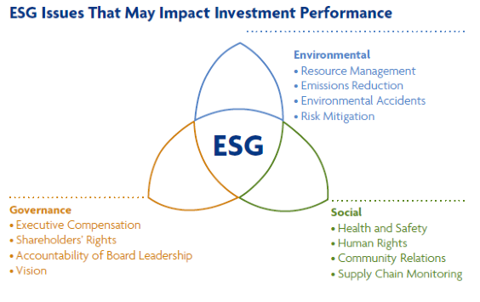
Sustainable Finance
Extreme environmental degradation and depleting natural resources have undoubtedly contributed to climate change and numerous natural catastrophes.
We witness almost daily on television and social media that the unnecessary, and in some cases unethical use of non-renewable resources globally has reached an unhealthy level.
Sustainable development has become a necessity and the investment community are becoming increasingly aware of the societal needs for sustainable investments.
Sustainable development is about using better ways to satisfy the demands of the population. It should be seen as meeting the needs of the current generation without compromising the needs for future generations. It requires accelerated innovation and appropriate use of technology, not only to protect the environment but also to cater for social wellbeing of communities and to ensure equal opportunity.
Notes:
Taken collectively sustainability efforts of the financial system aim at achieving the following:
Reorientation of investment flows to more sustainable outcomes including decarbonisation of investment portfolios
Raising finance to achieve the desired sustainable transition (funding long-term needs);
Direct corporate engagement to encourage adoption of more sustainable energy pathways and more sustainable business practices;
Enhanced disclosure/greater availability of Environmental, Social & Governance (ESG) information/data;
Greater standardisation/clarification of sustainability terms e.g. ‘green’.

Slide 4
Sustainable Finance
“sustainable growth will be one of the greatest challenges of the 21st century”
“ the full potential of the financial system needs to be harnessed to serve as an engine in the global economy’s transition toward sustainable development”
UN Environment/WB definition of sustainable finance: “ A sustainable financial system is stable and creates, values, and transacts financial assets in ways that shape wealth to serve the long-term needs of a sustainable and inclusive economy including all dimensions such as economic, social, and environmental issues; sustainable employment; education; retirement financing; technological innovation; resilient infrastructure construction; and climate change mitigation and adaptation”
....November 2017 UN Environment – World Bank Group Roadmap for a Sustainable Financial System
Notes:
Taken collectively sustainability efforts of the financial system aim at achieving the following:
Reorientation of investment flows to more sustainable outcomes including decarbonisation of investment portfolios
Raising finance to achieve the desired sustainable transition (funding long-term needs);
Direct corporate engagement to encourage adoption of more sustainable energy pathways and more sustainable business practices;
Enhanced disclosure/greater availability of Environmental, Social & Governance (ESG) information/data;
Greater standardisation/clarification of sustainability terms e.g. ‘green’.

Slide 5
Sustainability Principles for Exchanges
As a central point of contact for issuers, investors and market intermediaries, exchanges have long been recognized as important players in the sustainability transition.
WFE Sustainability Principles for Exchanges (Oct 2018):
Work to educate participants in the exchange ecosystem about the importance of sustainability
Promote the enhanced availability of investor-relevant, decision-useful ESG information
Actively engage with stakeholders to advance the sustainable finance agenda
Provide markets and products that support the scaling-up of sustainable finance and reorientation of financial flows
Establish effective internal governance and operational processes and policies to support their sustainability efforts

Slide 6
Sustainability Principles for Exchanges
-1-
Educate investors, issuers and market participants about sustainability challenges, and the risks and opportunities that (mis)management of ESG issues may present to financial markets
-2-
Issuing disclosure guidance to assist issuers in understanding what information to disclose and how best to present it
Organizing information-sharing and/or training sessions for issuers around ESG reporting
-3-
Engagement with regulators for necessary enabling environment
Contributing to the consensus around a sustainability taxonomy
Facilitating dialogue amongst capital market participants, such as issuers, investors and market intermediaries
Providing timely feedback and recommendations for supervisory bodies
Collaborating with other financial market participants to develop products or offerings to advance the sustainable finance agenda
Notes:
WFE Sustainability Principles for Exchanges (Oct 2018):
Work to educate participants in the exchange ecosystem about the importance of sustainability
Promote the enhanced availability of investor-relevant, decision-useful ESG information
Actively engage with stakeholders to advance the sustainable finance agenda
Provide markets and products that support the scaling-up of sustainable finance and reorientation of financial flows
Establish effective internal governance and operational processes and policies to support their sustainability efforts

Slide 7
Sustainability Principles for Exchanges
-4-
Creating frameworks for the listing of green, social and sustainability bonds
The development of sustainability indices
Supporting qualified green and/or social enterprises in obtaining financing via IPO and secondary offerings
Working with third parties to develop sustainability rating
-5-
Leading by example through incorporating ESG disclosure into the exchanges’ own sustainability reporting
Educating staff about sustainability risks and opportunities
Developing mechanisms to stay abreast of, and evaluate, emergent sustainability issues and incorporating these into the exchanges’ existing and future activities, as required
Establishing clear board and senior management oversight of the exchange’s own management of ESG risks and opportunities
Notes:
WFE Sustainability Principles for Exchanges (Oct 2018):
Work to educate participants in the exchange ecosystem about the importance of sustainability
Promote the enhanced availability of investor-relevant, decision-useful ESG information
Actively engage with stakeholders to advance the sustainable finance agenda
Provide markets and products that support the scaling-up of sustainable finance and reorientation of financial flows
Establish effective internal governance and operational processes and policies to support their sustainability efforts

Slide 8
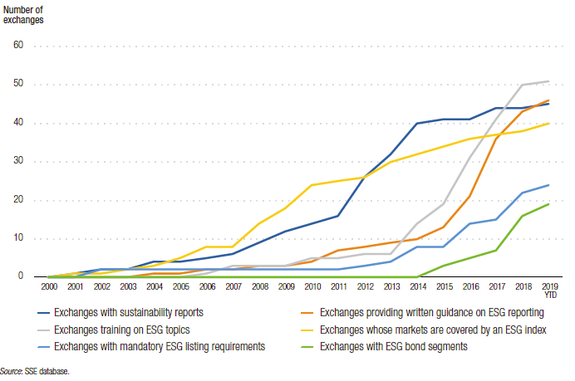
Sustainability Efforts of Exchanges
Notes:
UN-SSE in collaboration with WFE published a report; ‘How Exchanges Can Embed Sustainability Within Their Operations’ on 24 September 2019
Report provides a blueprint for embedding sustainability into exchange operations. The blueprint highlights four focus areas where exchanges can implement recommended practices and actions to ensure that sustainability becomes integrated across the business. These areas are:
Ensuring sustainability is integrated into the exchange’s strategic planning: the integration of sustainability into an exchange’s strategy and business plan should occur at the outset of the strategy development process, and form part of its vision and mission
Governance and risk management: an exchange’s senior management and leadership team should show commitment to embedding sustainability; sustainability should also be incorporated within the exchange’s structure and mandate
ESG impact, covering the management of the exchange’s direct impacts: exchanges should be able to leverage existing sustainability management resources to identify and manage the impact of their own operations on the environment and society. The exchange should develop policies, processes and procedures to address these operational priorities, which should be monitored and evaluated to track progress
Dedicated resources, to enable the sustainability work to move forward: either an individual or team should be responsible for overseeing the implementation of an exchange’s sustainability workplan. Fostering a broader sustainability culture, along with awareness programmes, can further steer an exchange towards improved sustainability. Initiatives can include greater communication of sustainability progress; an increased emphasis on recycling and energy efficiency; and opportunities for involvement such as volunteering.

Slide 9
Islamic Capital Markets and Sustainability
Islamic finance is embedded on the principles of fairness, equality and ethics that lead to social well-being. It seeks social justice and economic prosperity for the society and encourages sustainable economic activity. Islamic finance is derived from fundamental requirements set by principles of Islamic law.
Sustainable & Responsible Investment (SRI) shares a similar rationale. SRI is sometimes referred to as ‘sustainable’, ‘socially conscious’, ‘mission,’ ‘green’ or ‘ethical’ investing.
Islamic finance and SRI have been two of the most rapidly growing areas of finance over the last two decades. During this period, they have each grown at rates that far exceed that of the financial markets as a whole.
In 2014, climate themed bonds were estimated to total approximately US$502.6 billion globally (an exponential jump from US$174 billion in 2012). Estimates show that nearly US$10 trillion in cumulative capital investments will be moved towards low carbon energy alone between 2010 and 2020.
Furthermore, over 1,300 signatories to the United Nations Principles for Responsible Investment (UN PRI) represent over US$45 trillion in managed assets (from US$4 trillion in 2006).
Notes:
Source: http://www.capitalmarketsmalaysia.com/wp-content/uploads/2017/04/PDF-ICM_SRI-Booklet.pdf
In relation to these figures, Islamic finance remains a niche area that can benefit from broadening its horizon to tap into socially conscious investments.
This will appeal to and attract both Islamic capital as well as a wider global interest.
Therefore, understanding the scope of SRI is pivotal for Islamic finance practitioners to match the segment opportunity available in the SRI space.

Slide 10
Islamic Capital Markets and Sustainability
According to IFSB Islamic Financial Services Industry Stability Report 2019, the total worth of the industry reached $2.19 trillion in 2018 across three sectors including Islamic Capital Markets, Islamic Banking and Takāful. However, the growth has slowed to a single digit in last few years.
Islamic capital markets could broaden its investor portfolio by connecting these overlapping core values it has common with SRI in order to access the large amount of SRI funds globally available today.
Examples:
UK based BMO Global Asset Management’s Responsible Shariah Global Equity fund launched in 2011, aims to achieve long-term capital growth through a portfolio of global equities and seek out companies whose products and operations are not felt to be harming the world, its people or its wildlife, and are considered to be making a positive contribution to society.
Notable initiative is traced back to 2009 with Sustainable Asset Management (SAM), one of the leading asset managers in the field of sustainability investments, partnered with Gatehouse Bank to introduce the first ever Shariah-compliant water–focused investment strategy.
Notes:
Ethical, equitable, social and sustainable investments are all synonymous to both Islamic finance and SRI, and global efforts have been made to integrate these commonalities.
Examples among others include
UK Financial Services Authority adopts a broad spectrum policy of fairness and justice, and similarly this policy has also been strongly endorsed for Islamic finance by the Islamic Financial Services Board (IFSB 2009b: Principle 1).

Slide 11
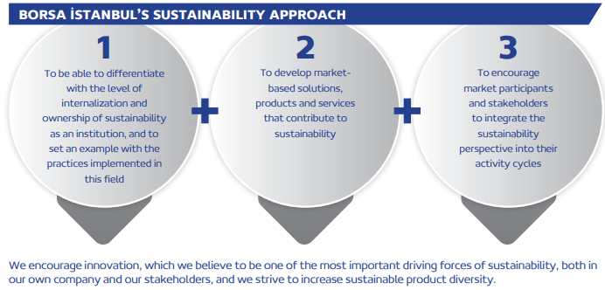
Borsa Istanbul Sustainability Efforts
Borsa İstanbul has a relatively limited environmental impact. On the other hand, stock exchanges are not only limited to their own activities in the fields of sustainability, corporate governance and social responsibility, but also play a transformative role by directing other organizations in their sphere of influence.
While contributing to corporate development of companies and investment environment, Borsa İstanbul aims to play a leading role in development and diversification of capital market instruments by integrating sustainability into decision-making mechanisms and business models by taking into account global risks and opportunities in developing a sustainable financial system.

Slide 12
Borsa Istanbul Sustainability Efforts
Sustainability Index: Launched on November 4, 2014. Companies listed 50
Corporate Governance Index: Launched on August 31, 2007. Companies listed 51
Sustainability Guide for Companies: Prepared by Borsa İstanbul in 2014 as a practical guide for companies on how to incorporate sustainabiity into their operations and providing them with a roadmap to follow.
Sustainability Platform: Initiated by Borsa İstanbul, aims to create a network of shareholders to facilitate concerted effort, new ideas and effective action and implementation. NGOs including sectoral unions, associations and foundations, international associations and regulatory authorities may be accepted as members to the Platform.
Sustainability Report / Annual Integrated Report: Prepared by Borsa İstanbul since 2014/2017
Environmental Policy: Borsa İstanbul Sustainability Committee is responsible for managing environmental sustainability. Energy usage, greenhouse gas emissions related to operations, other emissions, water and wastewater, waste management and recycling components are handled through environmental policy in compliance with relevant regulations.
Trainings and seminars: Sustainability and Integrated Reporting is promoted continuously througout workshops, seminars, trainings and gog ceremonies
Notes:
In 2018, 71 companies were assessed for inclusion into BIST Sustainability Index. The assessment process started with the announcement of the “List of Companies Subject to the Assessment”, which is also identified with the voluntary participation of the companies included in the BIST 100 or BIST Sustainability Indices, but not included in the BIST 50 Index. Ten companies that would be subjected to assessment for the first time underwent a preliminary assessment and their initial profiles were created and sent to the companies. These preliminary profiles are useful for the companies which have been assessed for the first time before the actual assessments, to understand their competencies and deficiencies in terms of sustainability and to overcome areas of weakness.
The assessments for BIST Corporate Governance Index, where the management-related topics identified by the CMB are taken into account, are performed by the rating agencies with which those companies wishing to be assessed are contracted. Companies scoring a rating in their compliance with corporate governance principles of at least 7 out of 10, and 6.5 out of 10 with regards to each main heading, are included in the index.
Borsa İstanbul, Capital Markets Board of Turkey, the Banks Association of Turkey, Turkish Capital Markets Association, Corporate Governance Association of Turkey, Business Council for Sustainable Development Turkey, Global Compact Turkey, Carbon Disclosure Project (CDP) Turkey, Turkish Industry and Business Association (TÜSİAD), Turkish Investor Relations Society (TÜYİD), Sustainability Academy, Sabancı University Corporate Governance Forum of Turkey, Arguden Governance Academy and Center for Finance, Governance and Sustainability, Integrated Reporting Network Turkey (ERTA).

Slide 13
Thanks

