Slide 1
Best Practices adopted by Clearing Company, also designated as “Central Counter-Party”
NATIONAL CLEARING COMPANY OF PAKISTAN LIMITED – NCCPL

Slide 2
Brief Overview of NCCPL Incorporation
In March 1999 the Capital Market Project Consultants (Arthur Anderson & Co.) were mandated to develop recommendations for a National Clearing and Settlement System (NCSS).
The design of the system was finalized in 2000 in consultation with all major capital market stakeholders.
National Clearing Company of Pakistan Limited (NCCPL) was incorporated on July 03, 2001 to manage and operate the National Clearing & Settlement System (“NCSS”) in a fully automated electronic settlement system.

Slide 3
Brief Overview of NCCPL Clearing & Settlement

Slide 4
Brief Overview of NCCPL Clearing & Settlement
Market Segments
NCCPL provides Clearing and Settlement Services for the following market segments :
Regular/Cash Market;
Odd-lot Market;
Derivative Markets (Futures and Stock Index);
Negotiated Deal Market; and
Debt Market

Slide 5
Best Practices adopted by NCCPL Governance
Shareholding Structure
Board of Directors
Board Committees
Management

Slide 6
Governance Shareholding

Slide 7
Governance Board of Directors

Slide 8
Governance Board Committees
Board of Directors
Chief Executive Officer
Risk Committee
Audit Committee
Human Resources & Remuneration Committee
IT Steering Committee
Whistle blowing Policy
Employee Grievance Policy
Dispute Arbitration Policy
The board and its committees are headed by Independent Director
Other Policies

Slide 9
Governance Management Structure

Slide 10
Best Practices adopted by NCCPL Central Counterparty
Legal Basis - covering each material aspect of clearing house activity
Governance Arrangement – clear and transparent
Management of risk – Credit, Liquidity
Securities and Money Settlement
Default management of participating organizations
General Business and Operational risk management

Slide 11
Legal Basis A clearing house should have a well-founded, clear transparent and enforceable legal basis for each material aspect of its activities.
Parliament of Islamic Republic of Pakistan
Securities Act
Futures Market Act
Securities & Exchange Commission of Pakistan
Clearing House Regulations
Securities Broker Licensing Regulations
National Clearing Company of Pakistan Limited
Regulations and Procedures;
Right to take Enforcement Action
Companies Act
Securities (Leverage Markets and Pledging) Rules;
Income Tax Ordinance
Code of Corporate Governance
Dispute resolution and arbitration;
Interdependences on related FMIs i.e. Stock Exchange, Depositories, Brokers, FIs.

Slide 12
Governance Structure – Risk Management
Risk Management Committee
Under supervision of apex regulator i.e. Securities and Exchange Commission
Risk Management Department headed by Chief Risk Officer
NCCPL’s Risk Committee is headed by an independent director and have representation from Management, Banks, Mutual funds, Stock Exchange, actuary and academia.
Regulations & Policies
Models and Systems
Monitoring and Reporting
-Membership criteria
-Margining Methodologies
-Position Limits
-Settlement mechanism - DvP
-Stress Test
-Reverse Stress Test
-In-House assessment of default fund size
-Back testing of margins, liquid financial resources & concentration limits
-Setting of Escalation levels
-Providing management, regulators, board, other stakeholders with information and decision oriented reports/ information

Slide 13
Management of Risk Clearing house should have a sound risk management framework for comprehensively managing credit, liquidity and other risks. - CCP should regularly review the material risk it bears; - CCP should provide incentives to participants to manage and contain the risk they pose to CCP.
Credit Risk
Developed a robust VAR based/ Position Limits framework to manage credit risk arising from payment and clearing process. The VaR is calculated at 99% Confidence Interval
Liquidity Risk
Liquidity risk is due to shortfall in settlement which may arise due to delay / default in fulfillment of its obligations by clearing members.
Back-up credit line facility availed from Commercial banks. Further, financial resources comprises of collateral and Settlement guarantee fund
Company has RTGS facility to monitor all activity live through out the day
Established a Settlement Guarantee Fund to strengthen its line of defense. Regularly test the sufficiency of total financial resources available to manage multiple defaults.
Accepts collateral with low credit, liquidity and market risk to manage the current and potential credit risk

Slide 14
Securities and Money Settlement
Securities Settlement
All transactions are settled at NCCPL on DVP-2 Model which eliminates the risk that securities may be delivered without receiving funds or funds may be paid without receiving securities.
Money Settlement
Each Clearing Member and/or the Company, as the case may be, will settle, by the Designated Time on the said Business Day, through a Settling Bank, the amount reflected in settlement statements.

Slide 15
Default management of participating organizations “Default management” refers to the financial safeguards available to a CCP to cover losses arising from a clearing member default losses and the order in which they would be utilized.
Step-1
Declaring a clearing member default upon non-fulfillment of its money obligation
Step-2
Clearing house would utilize Security Deposits of the defaulting clearing member
Step-3
Utilize Cash or cash equivalent deposited by clearing member

Slide 16
Default Management The default management mitigate moral hazard (arising from the Central Counter Party assuming that it will be protected from insolvency) by requiring the Central Counter Party to put additional significant portions of its capital at risk senior to Clearing Members contributions.
Step-4
Utilize amount from credit line facility availed by clearing house
Step-5
Utilize amount from Settlement Guarantee fund (SGF) or default fund.

Slide 17
General Business and Operational risk management A CCP should identify, monitor an manage its general business risk and hold sufficient liquid net assets funded by its equity to cover potential business losses so that it can continue as a going concern.
Operational Risk
Operational risk is covered through various implemented controls, including implementation business continuity plan / disaster recovery plan, implementation of physical and environmental security policy, restriction of access to data center through biometric devices, surveillance cameras, and insurance policy for property plant and equipment.
NCCPL’s risk based capital assessment has been conducted by an external / independent party.
There also exist in-house risk based equity/ capital assessments that help management and board to set equity levels in line with the risk taken by the organization.
Risk Based Capital Assessment

Slide 18
Service Portfolio
NCCPL provides following additional services:
Authorized Intermediary for margin Trading, Margin Financing and Securities Lending & Borrowing;
Unique Identification Number Registration;
Determination, Computation and Collection of Capital Gains Tax;
Murabaha Share Financing
Centralized Know Your Customer Organization; and
Bonds Automated Trading Platform

Slide 19
Service Portfolio Murabaha Share Financing
Concept
Murabaha is primarily a sale transaction which is used to finance the purchase requirements of the customer in a Shariah compliant manner.
This basically involves the purchase of the required security by the financier.
After the financier has completed the purchase of the security, it is sold to the customer at cost plus a disclosed amount of profit, with payment due at an agreed future date.

Slide 20
Service Portfolio Murabaha Share Financing
Need and Purpose
Shariah Complaint Financing has emerged as a viable alternate to conventional interest-based financing.
In the absence of any Shariah compliant financing, investors are deprived to purchase shares on credit in a Shariah compliant manner.
The growing interest and need of the investors has mandated to develop and introduce equity based Murabaha Financing Model for the capital market investors.

Slide 21
Service Portfolio Murabaha Share Financing
Need and Purpose Contd.
The interest free financing concept backed by Shariah approvals has tremendous potential to attract investors.
Murabaha Share Financing can be an attractive financing avenue for the Islamic banks operating in Pakistan due to limited availability of Shariah compliant investment options in capital market and excess liquidity available with such banks.

Slide 22
Service Portfolio Murabaha Share Financing

Slide 23
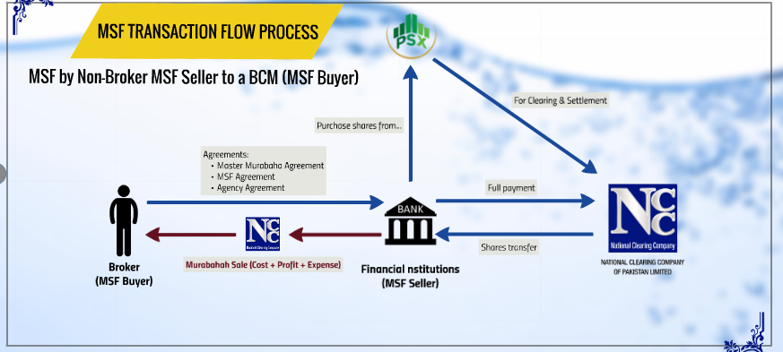
Service Portfolio Murabaha Share Financing

Slide 24
Service Portfolio Murabaha Share Financing

