Slide 1
Innovative Islamic Capital Market Instruments
A Quasi Equity Instrument for Corporations
Prof Dr Obiyathulla Ismath Bacha
OIC Exchanges Forum
September 26,2019
Istanbul, Turkey

Slide 2
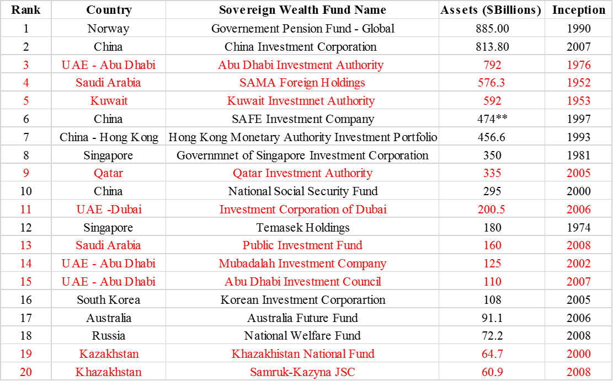
Source: Sovereign Wealth Fund Institute December 2016

Slide 3
Market Capitalization of Top Muslim Countries Stock Markets ( US$ Million), 03-Sep-2019 |  | Market Capitalization of Top 10 Fortune 500 Firms (US$ Million), 03-Sep-2019
Indonesia | 508,088 | Microsoft | 1,052,618
Saudi Arabia | 500,686 | Apple | 943,334
Malaysia | 382,092 | Amazon | 878,653
United Arab Emirates | 253,198 | Alphabet | 824,667
Qatar | 154,889 | Facebook | 529,707
Turkey | 150,034 | Berkshire Hathaway | 497,125
Kuwait | 100,442 | Visa Inc. | 394,955
Morocco | 61,964 | J.P. Morgan Chase | 351,276
Egypt | 50,841 | Johnson & Johnson | 338,763
Nigeria | 33,116 | Walmart Inc. | 330,890
Source: Bloomberg |  | Source: Thomson reuters eikon

Slide 4
Quo Vadis OIC Exchanges?
Debt Instruments or Equity?

Slide 5
Why do we need new instruments?
OCED - as at end 2018; https://www.oecd.org/corporate/risks-rising-in-corporate-debt-market.htm
Global corporate borrowing has ballooned to reach $13tn – more than double the level before the 2008 crash.
Companies around the world need to repay or refinance as much as $4tn over the next three years.
Average annual corp. borrowing - $864bn leading up to GFC (2007), but 2008 - 2018 the global average skyrocketed to $1.7tn per year.
Emerging market Corp. bonds total outstanding = USD 2.78 trillion in 2018, up 395% compared to a decade ago.
Worsening Quality share of lowest quality investment grade bonds stands at 54%

Slide 6
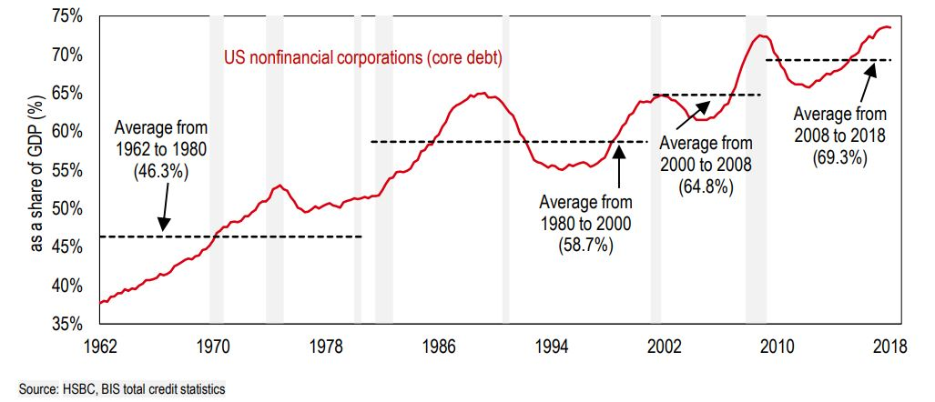
Corporate borrowing in addition to public debt is a key source of vulnerability to global growth.

Slide 7
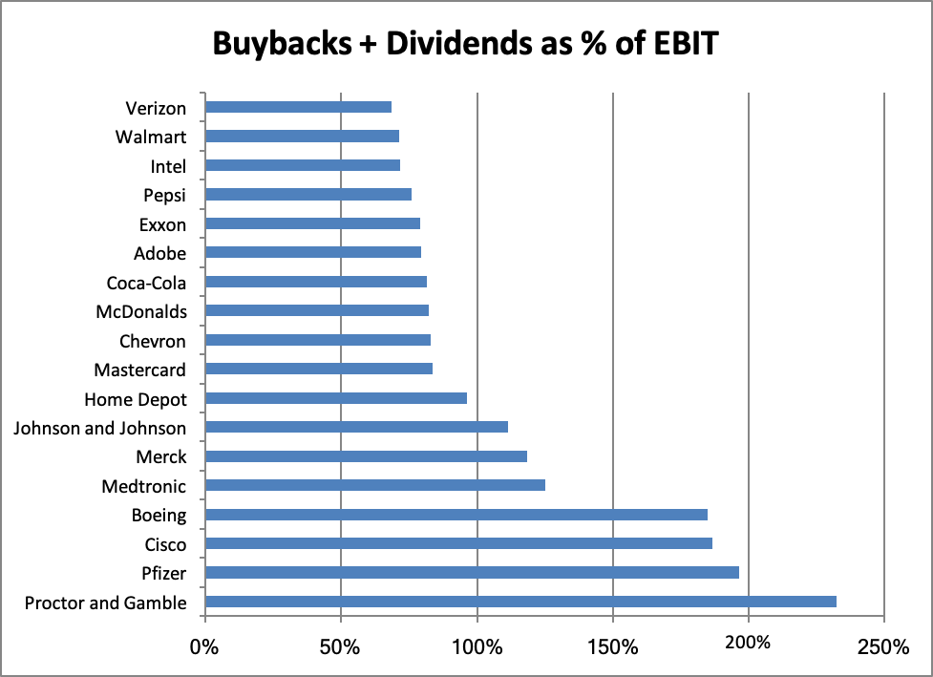
Hollowing out of the Corporation
As of the second quarter (2019), several S&P listed firms paid out more in dividends and buybacks than they earned
Source: Asia Times, 28th August,2019

Slide 8
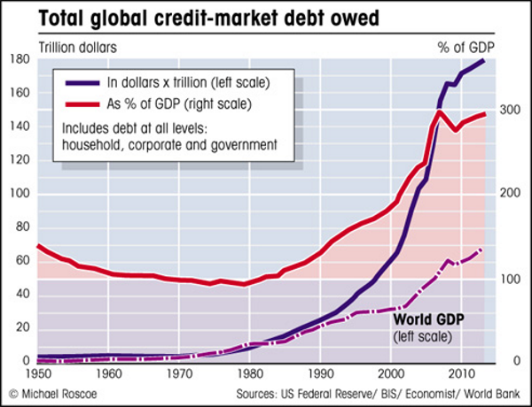

Slide 9
Dilemma for Corporations.
Companies need to grow, but growth needs to be financed.
With so much Corporate debt and equity being costly and dilutionary, is there an alternative? - Yes. Islamic Finance
Cheaper , no dilution but riskier, fixed obligations
Debt
Corporate Financing source
Safer, residual but costly and ownership/earnings dilution.
Equity

Slide 10
Contemporary Challenge
Reinhart and Rogoff (2010) - all crises of the past have been, at their core, debt crises. So, avoiding more debt is critical.
Need for an instrument
- That has advantage of debt but without the risk inducing feature.
also
Has the safety advantage of equity but without the permanent dilution.
The Islamic Risk sharing contracts of Mudarabah/Musyarakah can be modified to meet this challenge and provide a viable alternative for corporate finance.

Slide 11
Risk sharing principles as embodied in Islamic Finance have been in use extensively, 14th century Italian city-states “sea loans” and “commenda”.
Brouwer (2005) has traced risk-sharing contracts utilized in venture capital contracts in the Silicon Valley to the Medieval Italian city-states and the use of commenda.
Evolution from Mudarabah to Venture Capital financing.
Mudarabah
Commenda
Venture
Capital

Slide 12
Potential RSF Instruments for Corporates
RSF instruments not only shariah compliant but can avoid the negative externalities that arise from perverse incentives.
For example, US corporations borrowing to repurchase shares and pay higher dividends as a result of the low interest rates. Increasing firm value by altering the Debt-Equity ratio.
At a basic level, the shariah requires that financial contracts and instruments must be free of the following five items, (i) riba (ii) gharar (iii) maysir (iv) rishwah and (v) jahl.
Also, requirements like ensuring fairness and equity, a balance in the rights and obligations of both parties, that society is not harmed in any way but benefits from the transaction and finally, that there no fixity in returns.

Slide 13
RSF financing and claims/dilution.
Holding Company
Division I
Division 2
Division 3
Division 4
Proposed
New
Division

Slide 14
RSF Funding for Revenue Generating Projects
Features of RSF instrument
returns linked directly to the earnings of the project. (like equity)
claims only on the earnings of the new project. (unlike equity)
agreement on revenue recognition, identifying and measuring the relevant /allowable costs attributable to determining the earnings that will be shared.
underlying contract can be a modified mudarabah or musharakah combined with a wakalah.
instrument will be terminal and have fixed tenor

Slide 15
RSF Funding for Revenue Generating Projects
The appropriate tenor will depend on a number of factors:
  the economic life of the project or underlying asset
  the cash flows /earnings generated
  the profit-sharing ratio (PSR) and
  the required return given the riskiness of the project
The tenor designed to enable financier to get back his initial investment and required profit return.
a built-in mechanism that can protect the investor – equity-kickers
listed and traded on secondary markets. (like Tracker shares of US)
Not a debt instrument, so no leverage impact on firms.

Slide 16
Pricing Risk Sharing Sukuk for Corporations to Fund Revenue Generating Projects

Slide 17
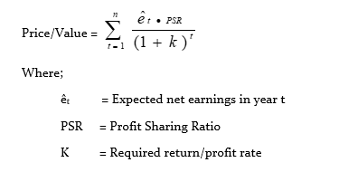
Pricing Risk Sharing Sukuk for Corporations to Fund Revenue Generating Projects
The valuation or pricing of such an instrument should follow the logic of valuation in finance. That is, value should equal the present-value of future expected cash flows from the investment.
Generically:

Slide 18

The (PSR) set such that the initial investment (I) is recoverable given the required profit rate and term.
The PSR, therefore, is a function of the term, average expected earnings, initial investment and the required profit rate:
PSR = ƒ (I, T, ē, K)
Where:
ē = average of expected annual earnings
The appropriate term should differ according to the project being financed. Generically, the term can be determined as:

Slide 19

For a given set of expected future earnings, term and PSR, the required return will be implied in its market price:
% K, would constitute both the returns from profits received and capital gains.
For initial pricing, indicative ‘K’ can be derived from the ROA (return on assets) of similar projects/industry.

Slide 20
Debt, Equity and Mudarabah;
Payoff Profiles.

Slide 21
How does debt increase leverage?
Base Case: New Division
Units Produced & sold 1,000
Price per unit RM250
Variable cost per unit RM 25
Financing of New Division with Debt with Equity
Sales Revenue RM250,000 RM250,000
Total Variable costs RM 25,000 RM 25,000
Fixed operating cost RM100,000 RM100,000
Interest expense ( @10%) RM 55,000 0
PBT RM 70,000 RM 125,000
Breakeven point (TFC/ P-VC) 688 units 444 units

Slide 22
What does leverage do? New Division
Suppose Sales Increase 10%
Debt Financed Equity Financed
Sales Revenue 275,000 275,000
Total Variable cost 27,500 27,500
Fixed operating cost 100,000 100,000
Interest expense ( @10%) 55,000 0
PBT 92,500 147,500
% change in PBT 32.14% 18%

Slide 23
What does leverage do? New Division
Suppose Sales decrease 20%
Debt Financed Equity Financed
Sales Revenue 200,000 200,000
Total Variable costs 20,000 20,000
Fixed operating cost 100,000 100,000
Interest expense ( @10%) 55,000 0
PBT 25,000 80,000
% change in PBT - 64.3% -36 %

Slide 24
What does leverage do?
Debt
BEP444
Notes:
LOS: Define and explain leverage, business risk, sales risk, operating risk, and financial risk and classify a risk, given a description.
Page 172–175
What Does Leverage Do Exactly?
Changes in units produced and sold affects not only operating earnings’ volatility, but also net income as well.
The combined effect makes Company Two more profitable with more units produced and sold, but also riskier (similar to Exhibit 4-3).
We can use simulations to get a better idea of the risk created by leverage (see Exhibit 4-4).

Slide 25
Suppose each firm now replaced 50% of its debt with Mudarabah financing, What happens?
What does leverage do?
What if we now had Mudarabah Financing?

Slide 26
What does leverage do?
Sales Increase 10% Sales decrease 20%
New Division (with Mudarabah financing of 50% of debt)
Sales Revenue RM 250,000 275,000 200,000
Total Variable costs RM 25,000 27,500 20,000
Fixed operating cost RM100,000 100,000 100,000
Interest expense ( @10%) RM 27,500 27,500 27,500
PBT RM 97,500 120,000 52,500
percentage change in PBT 23.08% - 46%

Slide 27
What does leverage do?
Sales Increase 10% Sales decrease 20%
New Division (with Mudarabah financing of 0% of debt)
Sales Revenue RM 250,000 275,000 200,000
Total Variable costs RM 25,000 27,500 20,000
Fixed operating cost RM100,000 100,000 100,000
Interest expense RM 0 0 0
PBT RM 125,000 147,500 80,000
% change in PBT 18% - 36%

Slide 29
Impact on | Net Profit
 | Only Debt | 50% Mud/D | 100%Mud, 0 Debt
 | -42500 | -13,335 | 6807.5
 | -20000 | 4,667 | 19601
 | 1750 | 18,669 | 31,315
 | 17500 | 32,671 | 43,568
 | 33250 | 46,673 | 55,822
 | 49000 | 60,674 | 68,075
 | 64750 | 74,676 | 80,329
 | 80500 | 88,678 | 92,582
 | 96250 | 102,680 | 104,836
 | 112000 | 116,681 | 117089
 | 127750 | 130,683 | 129342.5
Mean | 47295.45 | 60310.57 | 68124.09
Std Dev | 52412.35 | 44863.51 | 38687.14
Std. Dev % | 111% | 74% | 57%

Slide 30
Payoff to Equity holders over business cycles (PSR 30:70)

Slide 31
Conclusion : Proposed Instruments – How do they stack up?
I. For investors of the proposed instruments
  Earn more relative to debt instruments
  Returns are anchored in real returns which are much more stable.
  Form a new asset class.
  Strong diversification possibility when combined with conventional portfolios
  Low denomination and secondary market trading provides easy access; ensures pricing transparency and has minimal liquidity risk.

Slide 32
II. For shareholders of the issuing firm
  External financing without the leverage and with minimal and temporary dilution in earnings.
  Asset specific dilution is terminal and ceases with maturity.
  Taken together, these two advantages effectively change the debt-equity trade off.
  the advantage of debt without the riskiness and the lower risk of equity without the dilution. (lower beta)
  no incentive to take on risky projects the way debt financing does.

Slide 33
  For the government and Society.
    Improvement in macro-economic stability.
    Capital markets get developed
    Savings that would go into speculative assets, can now be harnessed for development
    Promote financial inclusion investment possibilities to a larger portion of the population
    Less leverage in system, banking sector vulnerability and moral hazards are minimised.
    government tax revenue increases –as the tax subsidy for debt is reduced.

Slide 34
Obiyathulla Ismath Bacha
Professor of Finance
603-76514188
obiya@inceif.org

